Slide 2
ACTIVE
LEARNING

Slide 3
Active Learning
Active Learning occurs when Experience, whether Online, in the Classroom, or On-the-Job (OJT), stimulates Mental Activities that lead to Meaningful Learning.
?

Slide 4
To properly size conductors for a blah…blah…blah
Section xxx of the NEC is used to blah..blah..blah
Just “Telling” (LECTURE) is not “Teaching”

Slide 5
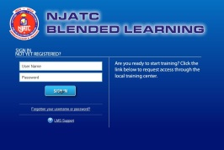
LMS
Review
The Online Homework includes many different components:
Assignment Overview
Learning Objectives
Reading Assignments
Graphic Animations
Immersive Videos
Interactive Simulations
Reflective Homework Questions
Respond
The Apprentice does all Homework online.
Same content as the Workbook!
Try doing these in the Workbook
They can easily be done in the LMS

Slide 6
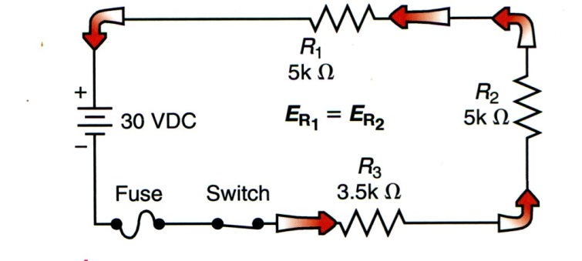
What if printed book illustrations like current flow,
motor rotation, or magnetic fields could be
animated and not just shown as a flat image?
In the LMS
are used to Illustrate Electrical Circuits
And Electrical Equipment Operations
Graphic Animations

Slide 7
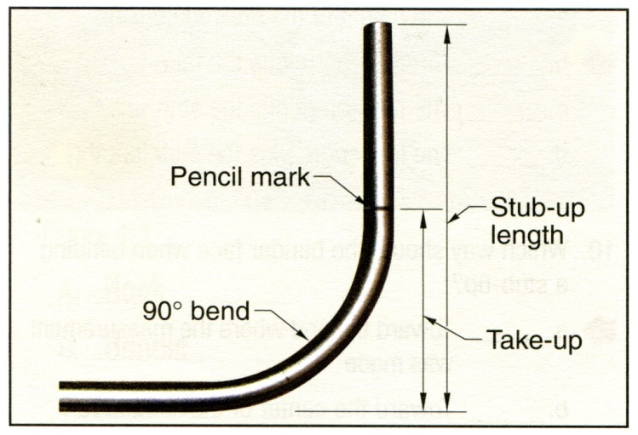
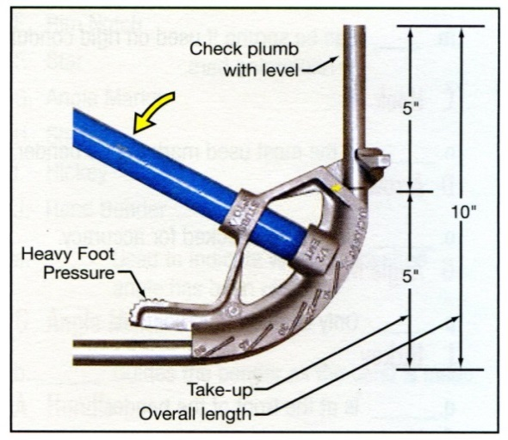
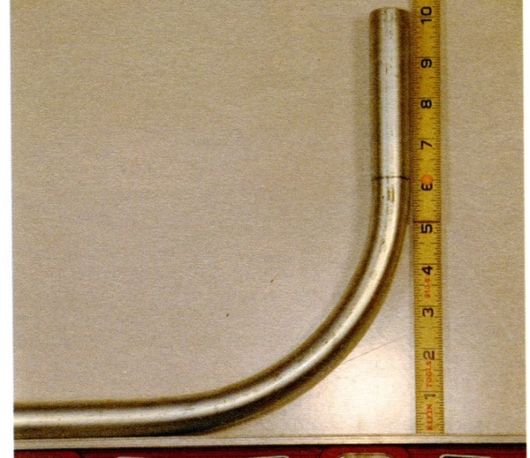
What if complex tasks could be shown in
live step-by-step video demonstrations?
In the LMS
are used to Illustrate Conduit Fabrication
And Other Physical (Hands-On) Tasks
IMMERSIVE VIDEOS

Slide 8
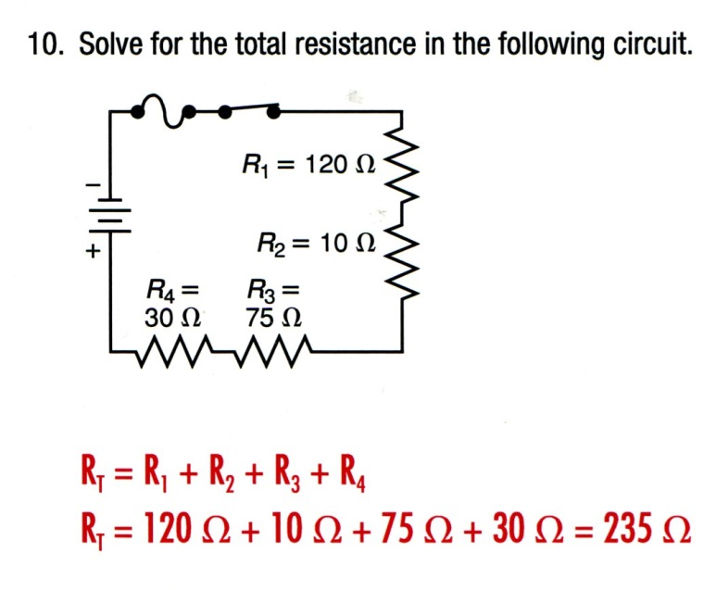
What if simulators allowed apprentices
to complete hands-on exercises virtually?
In the LMS
are used to allow Apprentices to build and
test circuits using realistic test equipment
INTERACTIVE SIMULATIONS

Slide 9
What if the apprentice could submit his or her
homework, and then go back to check that work?
May or may not get discussed in class
There are 65 questions in this lesson
Which questions are most important?
In the LMS
allow apprentices to self-check their
own homework answers before class
Reflective Homework QUESTIONS

Slide 10
ACTIVE LEARNING
Provides content to stimulate and motivate the apprentice
Helps apprentices develop critical thinking skills
Helps the apprentice understand the content
Provides immersive activity encouraging the apprentice to:
Think
Explore
Engage

Slide 12
INSTRUCTOR
LOG-ON

Slide 13
How Does the
Instructor
Access the LMS
www.njatc.org

Slide 14
http://blendedlearning.njatc.org/login/index.php

Slide 15
http://blendedlearning.njatc.org/?theme=njatc_instructor

Slide 17
INSTRUCTOR
BUTTONS

Slide 18
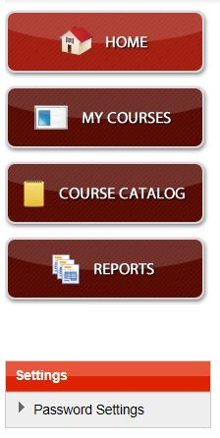
18

Slide 19
Instructor Home Page “HOME” Button
Can be accessed from any page
Always returns the user to the Instructor Home Page
Provides a consistent entry point to the LMS
19

Slide 20
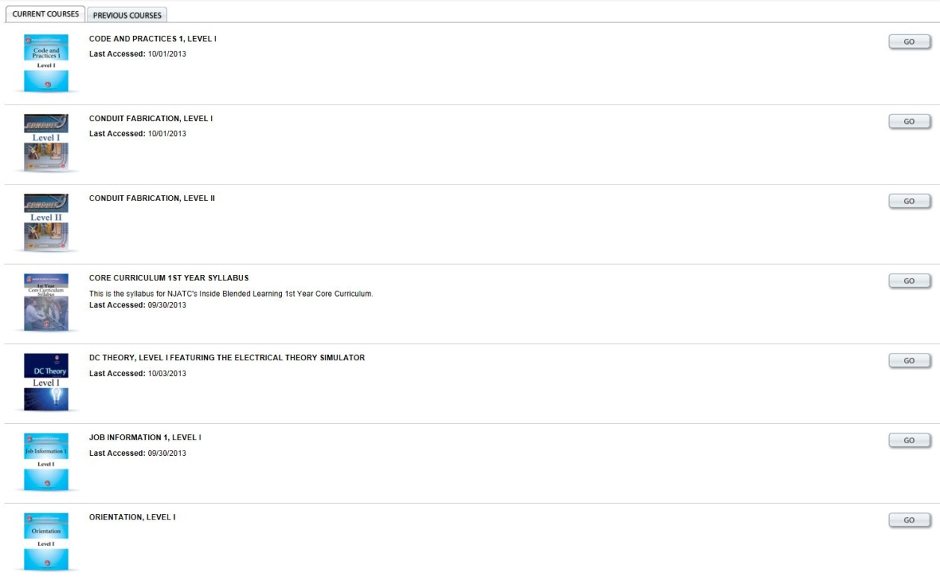
“MY COURSES” Button
Can be accessed from any page
Shows the courses which the Instructor has been registered to review or use
These are the courses which that Instructor can access and explore or use as a teaching resource.
20

Slide 21
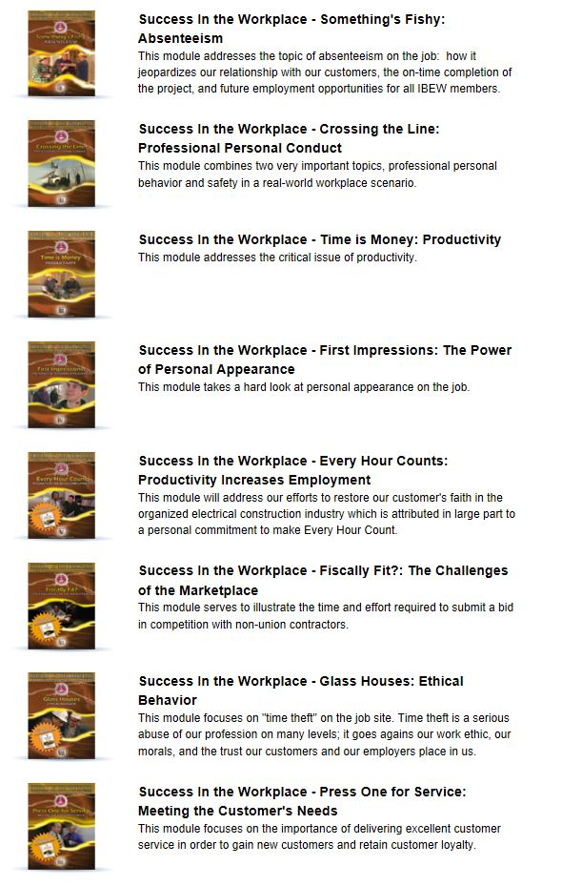
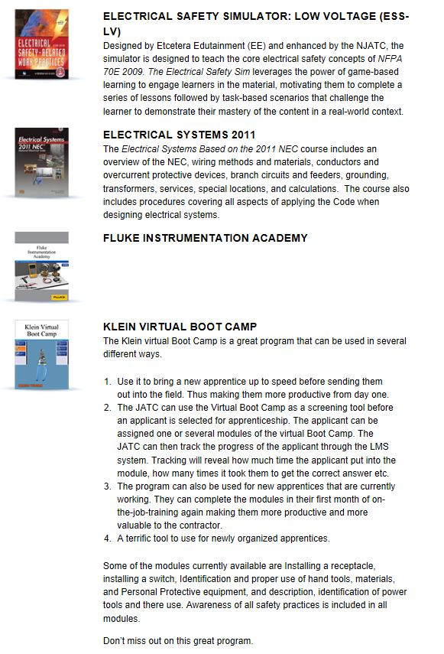
“COURSE CATALOG” Button
Can be accessed from any page
Lists additional courses available for CET usage, or for use by apprentices who need to complete additional courses which are not included in the apprenticeship curriculum
This button does not provide access to these courses
These courses must be selected by the JATC Administrator as part of the Apprentice’s curriculum
21

Slide 22
“REPORTS” Button
Can be accessed from any page
Allows the Instructor to view various reports from the courses which that Instructor teaches
Does not show reports for other courses in the JATC or for other JATCs
Instructors can select the report which shows data which the Instructor can use to prepare lessons plans for face-to-face classes
22

Slide 23
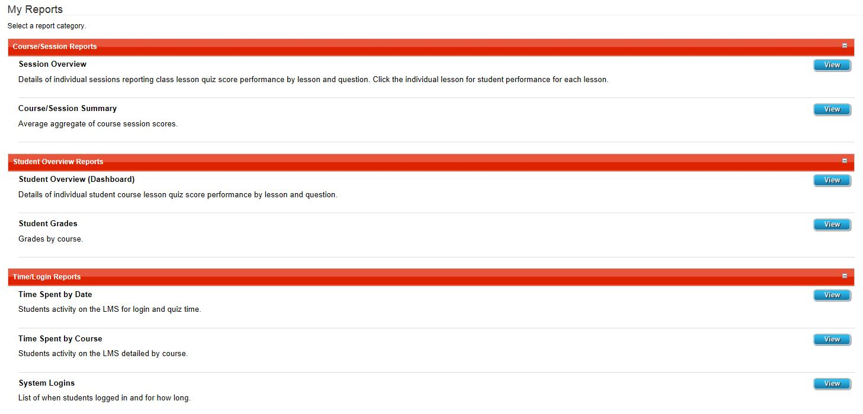
23

Slide 24
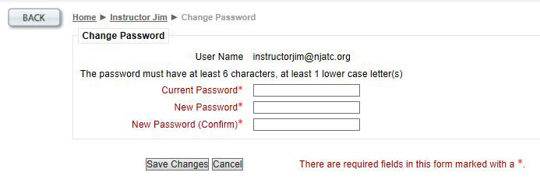
“SETTINGS” Link
Opens to show “Change Password”
24

Slide 25
Instructor Buttons
25

Slide 27
INSTRUCTOR
ACCESS TO
RESOURCES

Slide 28
Instructors can access online simulations, animations, and other resources during class the same way apprentices access them doing homework, and can use those resources to present or clarify information
For example:
28

Slide 29
Start on the Instructor Home Page
Click the “My courses” Button
CLICK HERE

Slide 30
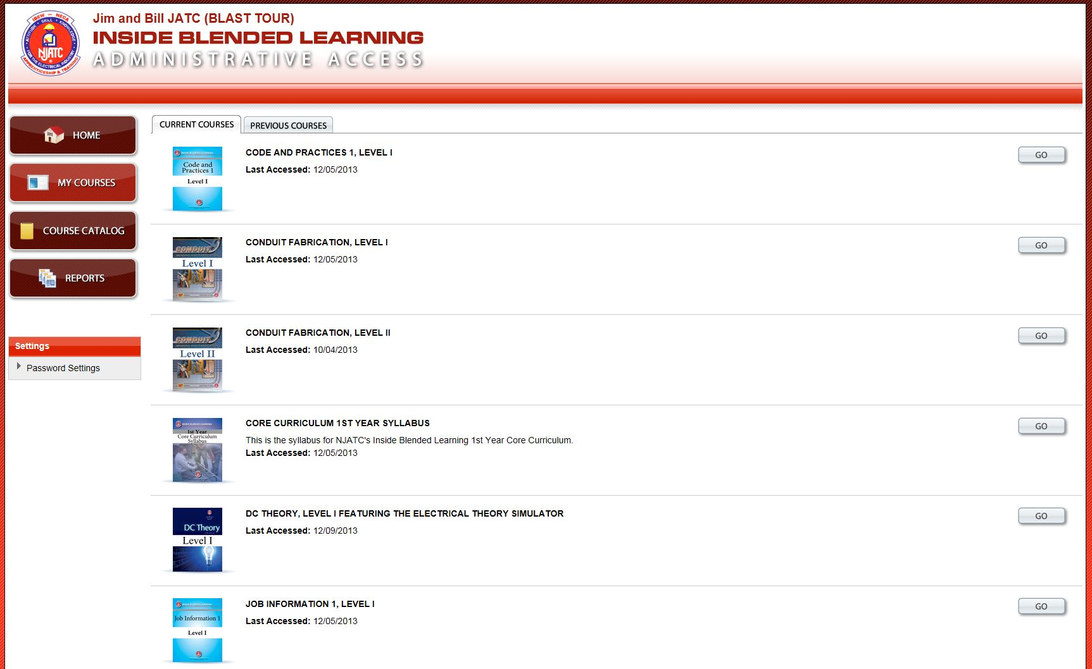
Click on the course you wish to access
CLICK HERE

Slide 31
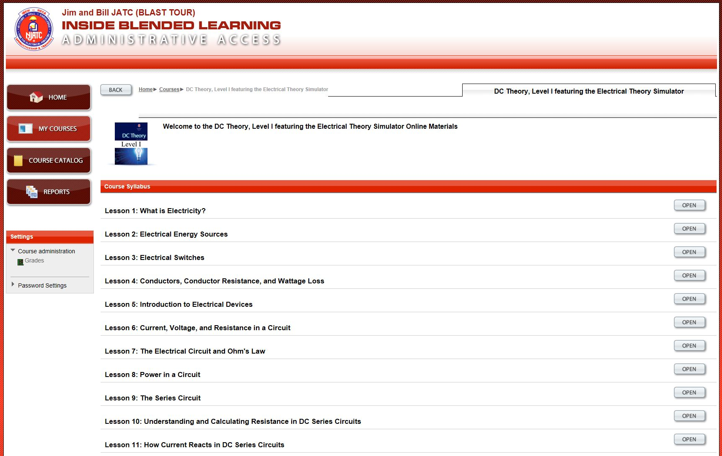
Click on the Lesson you wish to access
Click “Open” to Review and/or Access
the Content from any Lesson

Slide 32
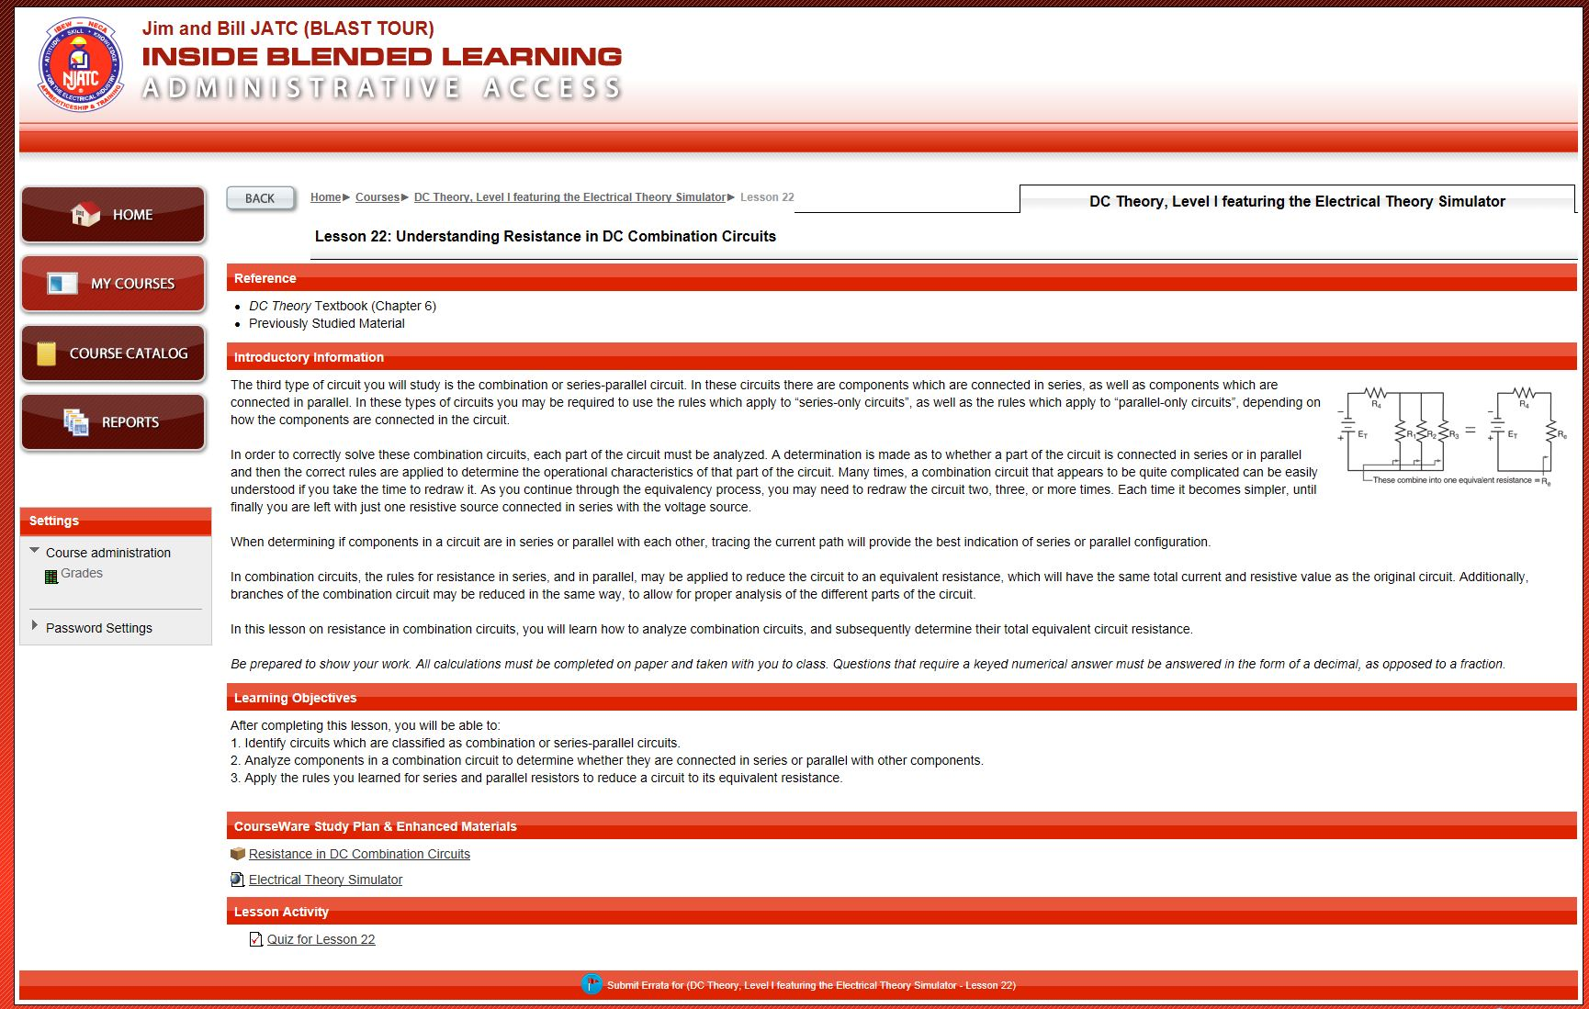
Click on the Content Link for any content you wish to access
Click on the Link to access Enhanced Materials

Slide 34
Click on the Content Link for any content you wish to access
Click on the Quiz Link to access the Homework Quiz

Slide 35
NOTE: The Homework content may be accessed in either
Student View
Answer Key View

Slide 37
INSTRUCTOR
REPORTS

Slide 38
Instructors have access to Course/Session, Student & Time Reports:
Reports are only for the Courses & Students assigned to that Instructor
Course/Session Reports
Session Overview
Details of individual sessions
Course/Session Summary
Average aggregate of course session scores
Student Overview Reports
Student Overview (Dashboard)
Details of individual student course level scores by lesson and question
Student Grades
Grades by course
Time/Login Reports
Time Spent by Date
Student Activity on the LMS for login and quiz time
Time Spent by Course
Student Activity on the LMS detailed by course
System Logins
List of when student logged in and for how long
38

Slide 40
BLAST II
Using the Resources
Dates

Slide 41
BLAST II – Active Learning
in the Classroom – Preparing to Teach
Don’t forget to plan for BLAST II
Oakland, CA April 1, 2014
Denver, CO April 3, 2014
Houston, TX April 15, 2014
Atlanta, GA April 17, 2014
Nashville, TN May 7, 2014
Louisville, KY May ? , 2014
Boston, MA May 20, 2014
Philadelphia, PA May 22, 2014
Omaha, NE June 3, 2014
Milwaukee, WI June 5, 2014
41

