Slide 2
BILL PRESENTATION
What is Blended Learning?
Notes:
This is just a slide to indicate the beginning of a section…….It MUST stay hidden…..

Slide 3
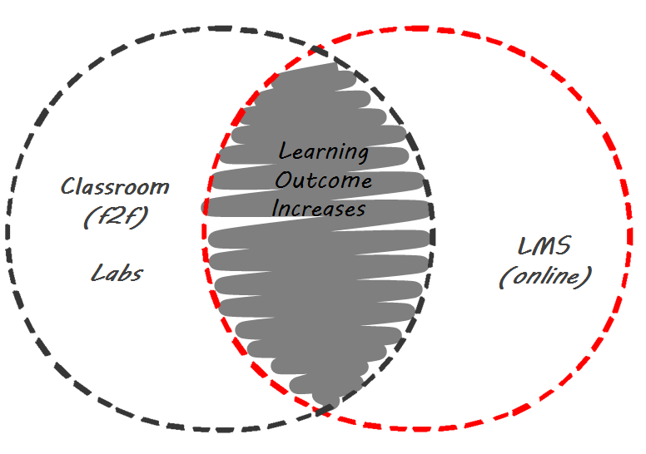
Blended Learning
For Apprenticeship & CET & CET
20

Slide 4
Apprentice
Future Success of the IBEW/NECA Workforce

Slide 5
CET
Continuing Electrical Training

Slide 6
LMS
Learning Management System

Slide 7
Tomorrow’s
Classroom
Culture Change

Slide 8
Blended Learning Delivery
Learning
Outcome
Increases.
Classroom
(f2f)
Labs
LMS
(online)

Slide 9
Curriculum Design
Instructional Design

Slide 10
Curriculum Design
The structure, scope, sequence, content,
and skills to be taught
as a set of courses
Course Design based on:
Customer needs through a set of Learning Objectives.

Slide 18
Blended Instructional Design
Presenting Content in Ways that Help People Learn
Classroom
Instructor lead (Initial Intro)
Self Study
Recap & Hands-On
Online
Self-paced
Multimedia & Virtual Training
Self Assessment.

Slide 19
Adaptive Teaching Group & individual
Evaluate the students to learn their backgrounds, skills, learning styles
Monitor their performance both in the classroom and on the LMS
Utilize various instructional techniques for each topic and class as a whole
Cover content as indicated by the LMS assessments and activities
Utilize virtual and hands on activities to support the learning that did not occur
Create support teams for the students. Provide additional resources to learning.

Slide 20
Core
Courses
Advance
Courses
Applications

Slide 21
Technology Learning
tLearning
eLearning
Pedagogical
On-Line
Cloud
Interface
Design
Evaluation
Resource
Management
eLearning

Slide 22
Technology Learning
tLearning
mLearning
Smart
Phones
Tablets
(Puffin)
Kiosk
eLearning
mLearning

Slide 23
Technology Learning
tLearning
3D
Interactive
Responsive
Branch
Logic
Avatars
(2nd Life)
eLearning
mLearning
vLearning

Slide 24
Classroom Time Management & Efficiency
Content: Initial delivery of topic to more detail
Labs: Both Hands-on and Virtual
Homework Review: Weekly customized coverage based on LMS Reports
Certs: National & Local Certifications

Slide 25
Applications for the Classroom
Equip/BIM Drawings
Training Partners
Local Building Commissions
Statewide
Codes
Khan Academy (www)
Poll Everywhere
Internet resources used during the classroom and labs can enhance the students learning both for studying and on the job performance.

Slide 26
What have you learned about Blended Learning?
Blended learning - the best of both worlds
Online
Apprentices can learn fundamentals, theory, and processes using an online format at their own pace
Theory learning is enhanced using animations
Hands-on activity can be replicated using interactive simulations or game-based learning
Classroom
Instructors will know how apprentices are doing before they come to the classroom
More time will be available for focused learning
Additional time can be used for hands-on learning

Slide 27
LMS

Slide 28
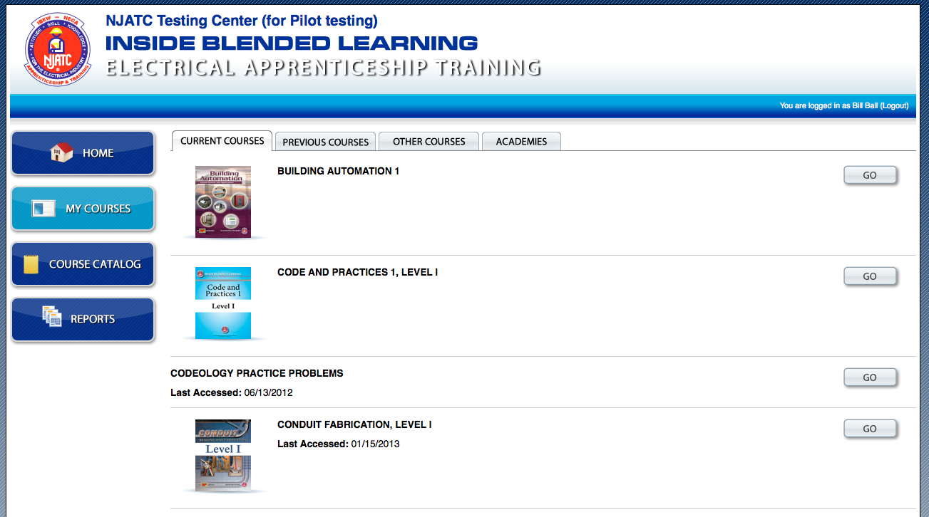

Slide 29
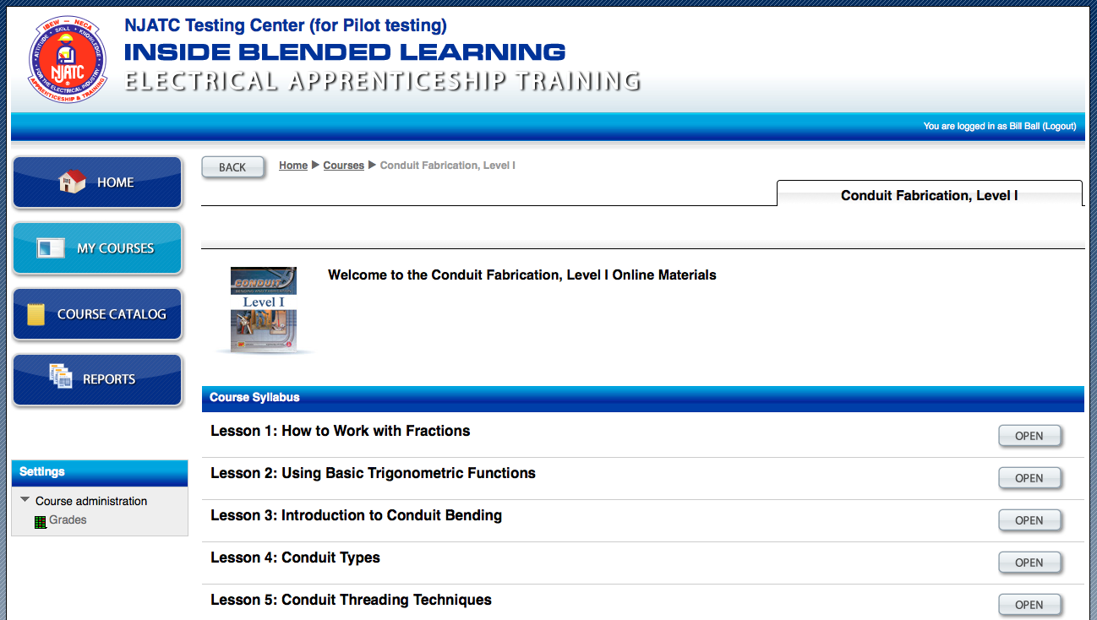

Slide 30
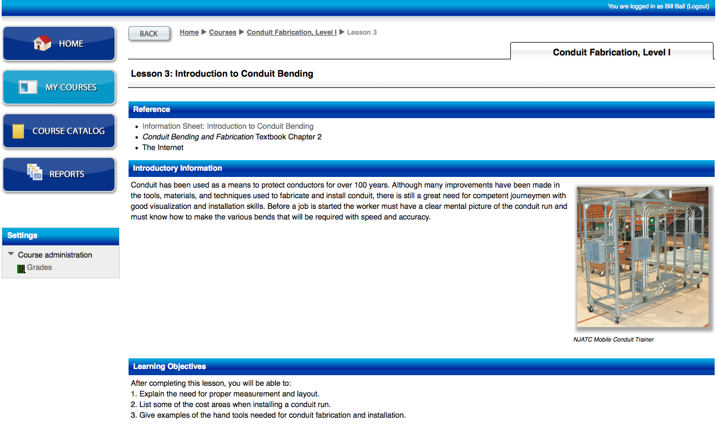

Slide 36
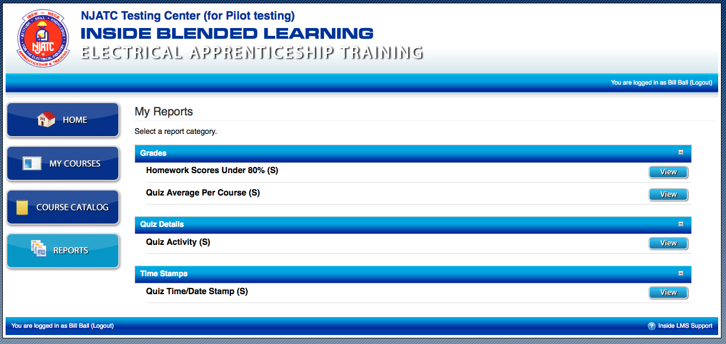

Slide 37
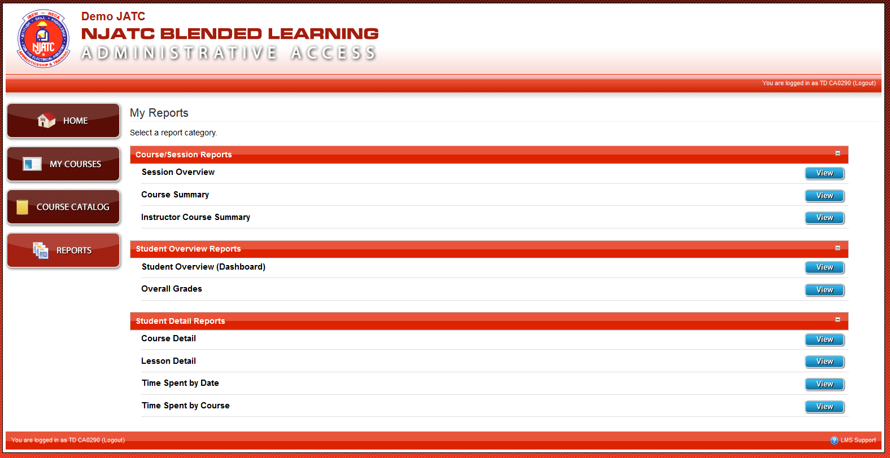

Slide 38
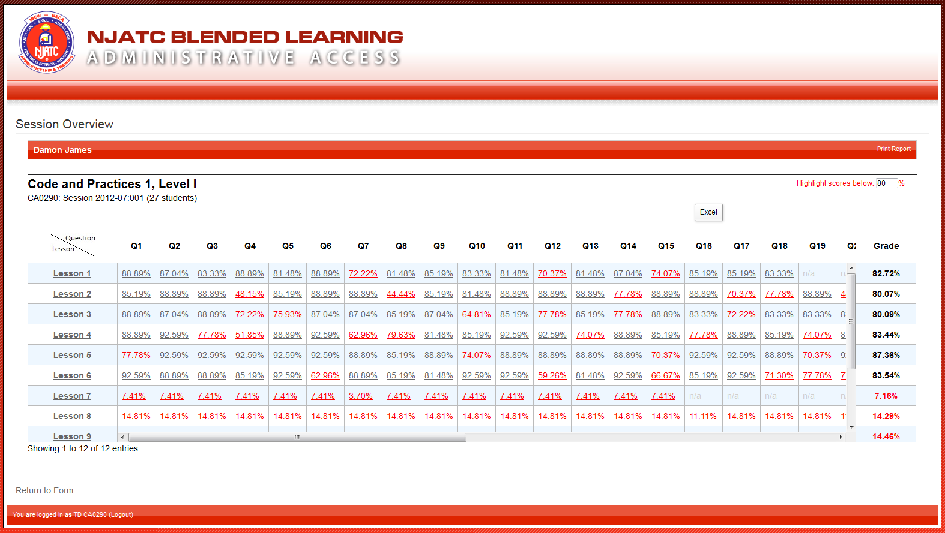

Slide 40
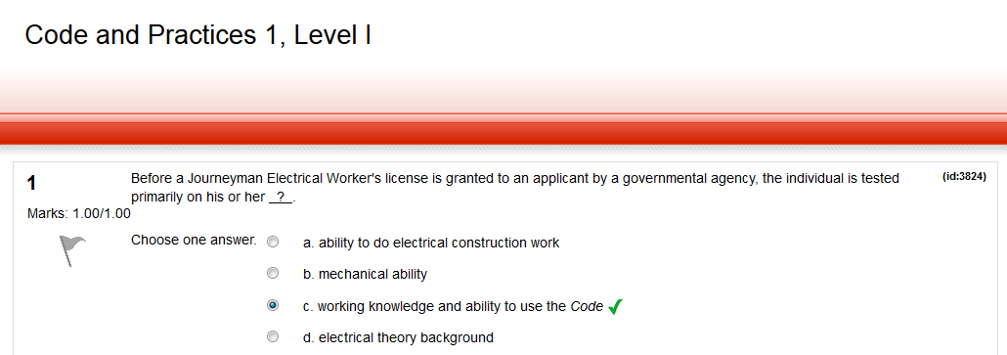

Slide 42
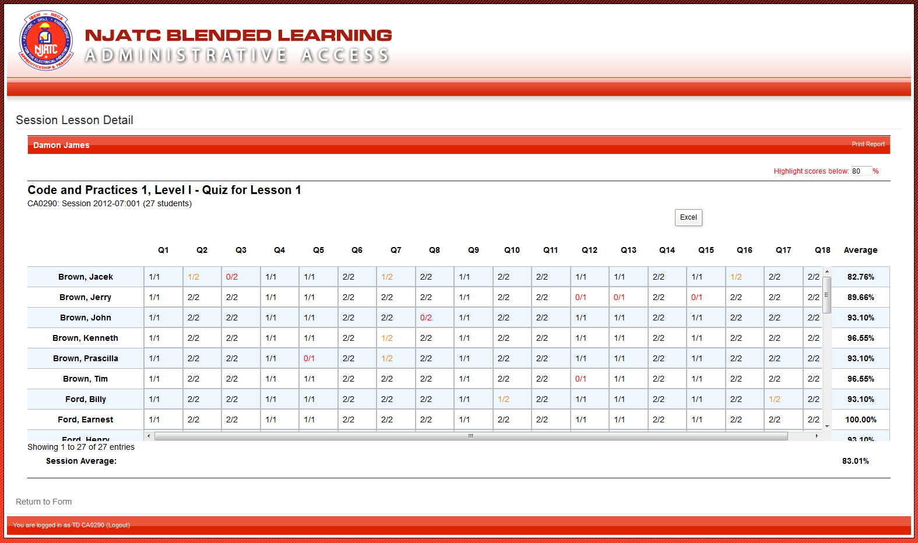

Slide 43
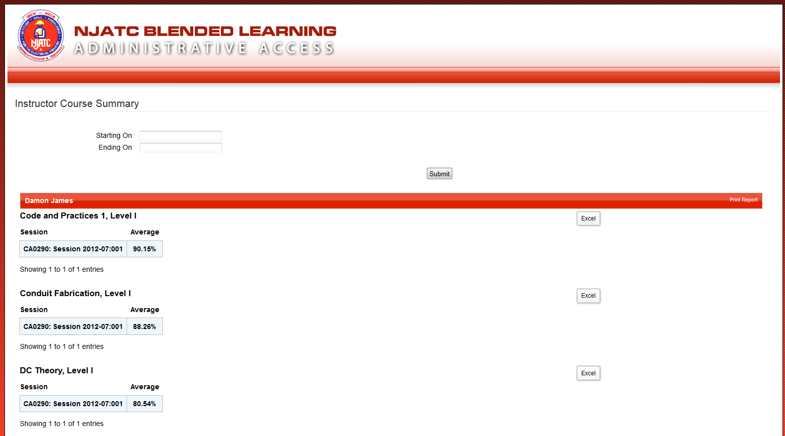

Slide 44
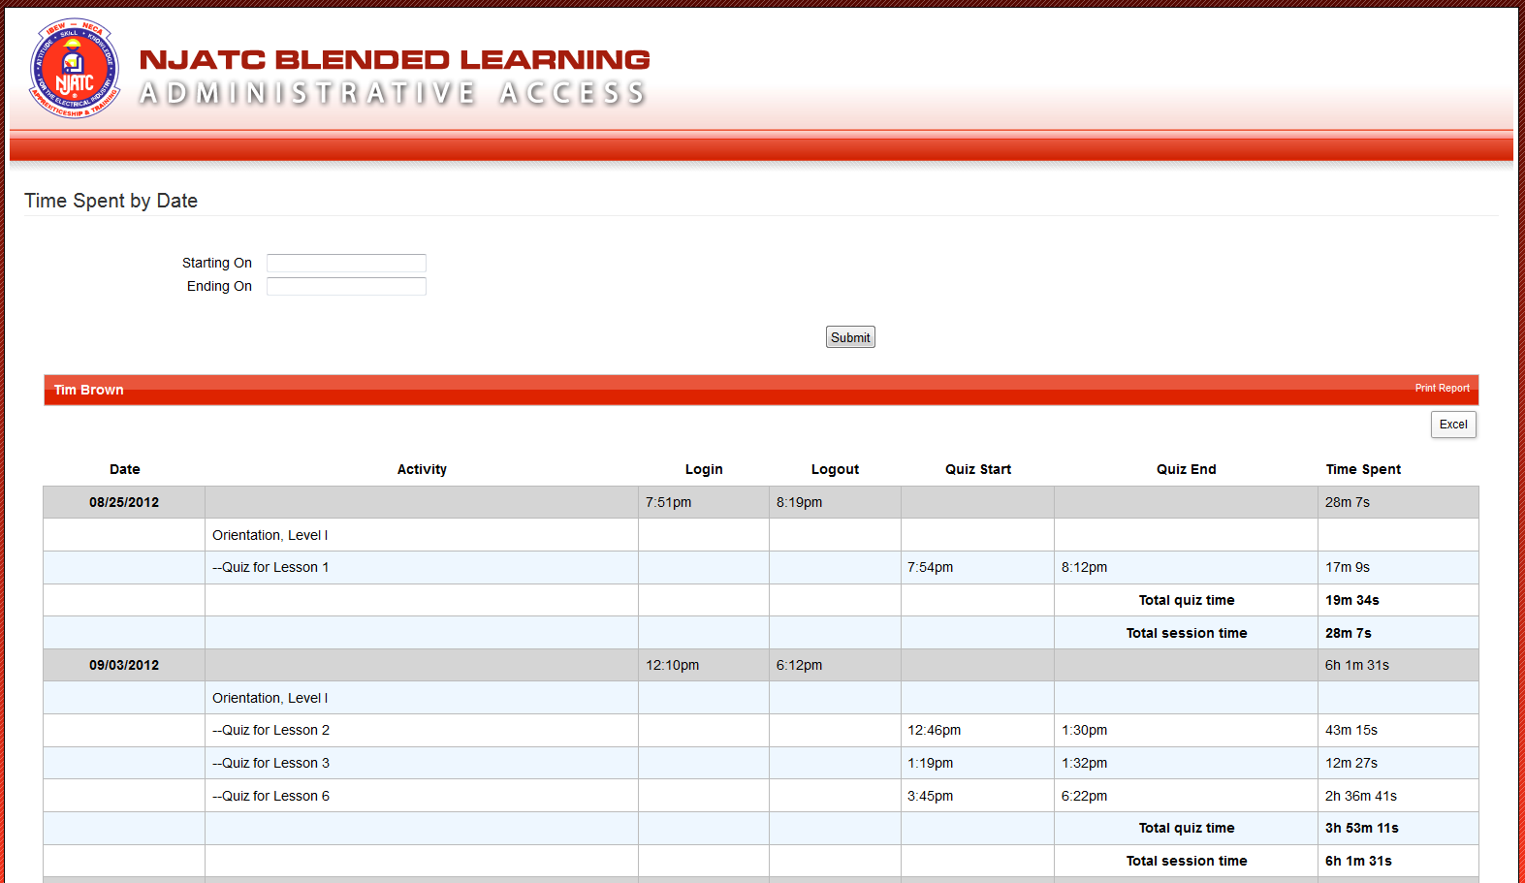

Slide 45
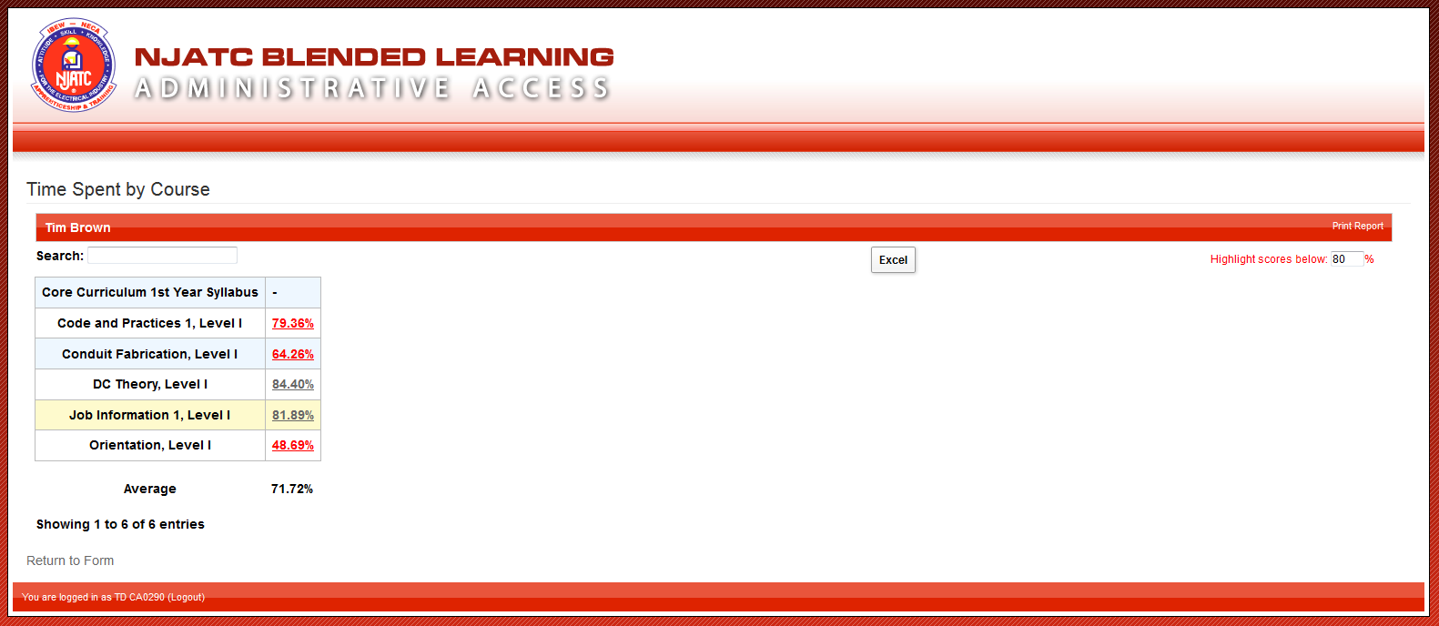

Slide 46
Interactive

Slide 47
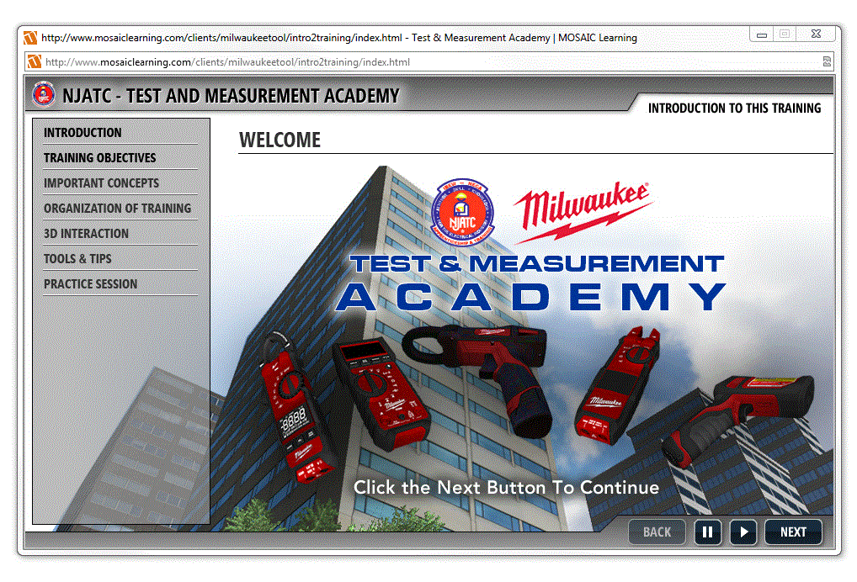

Slide 48
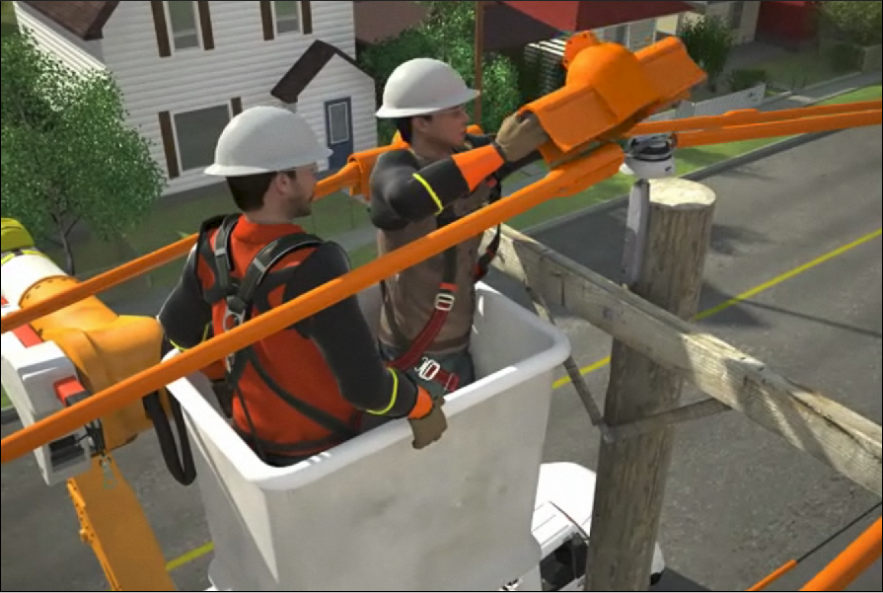
Cover-up

Slide 50
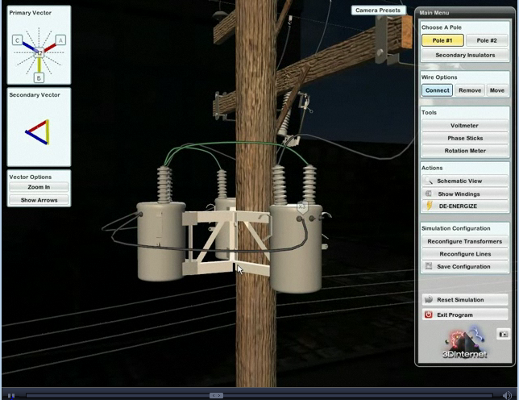
Outside
Transformer
Simulator

Slide 51
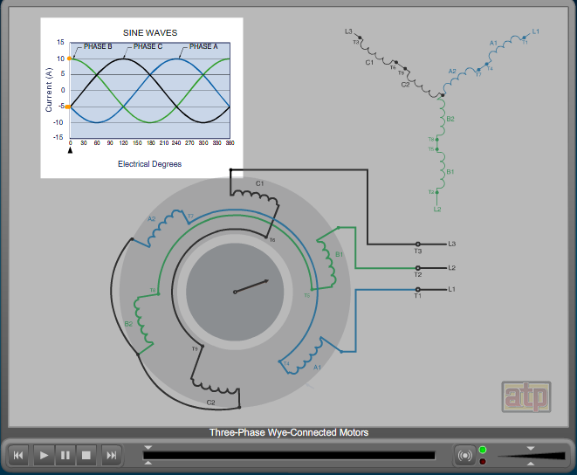

Slide 52
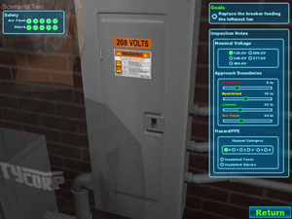
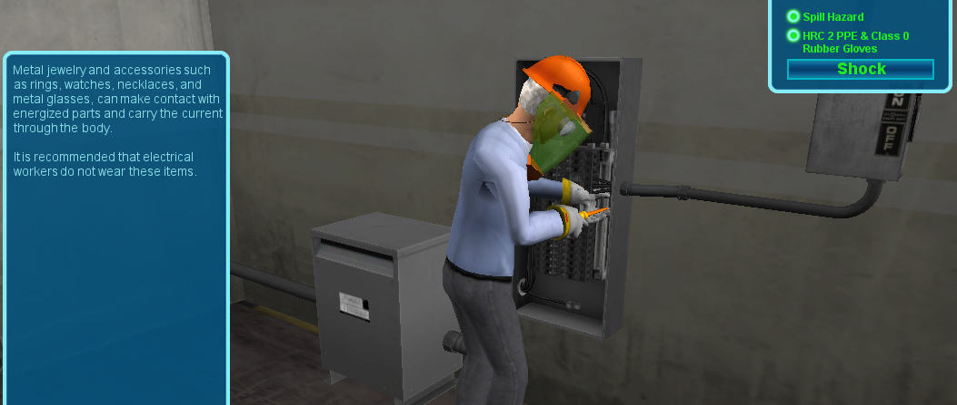
Electrical Safety Simulator

Slide 53
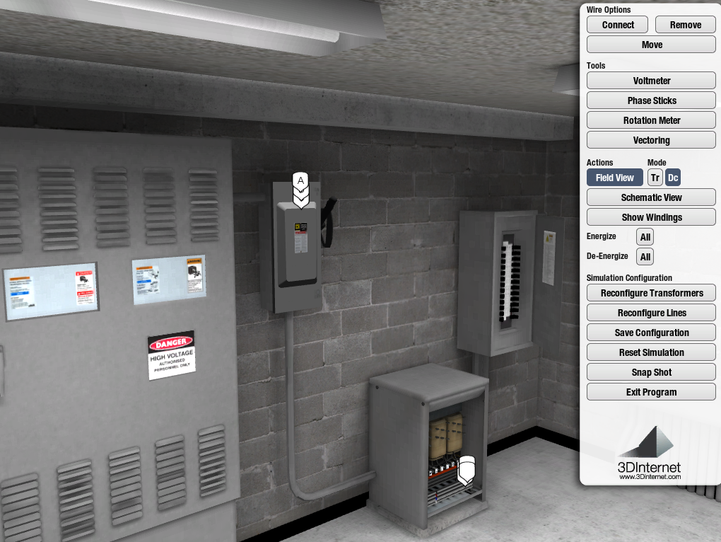
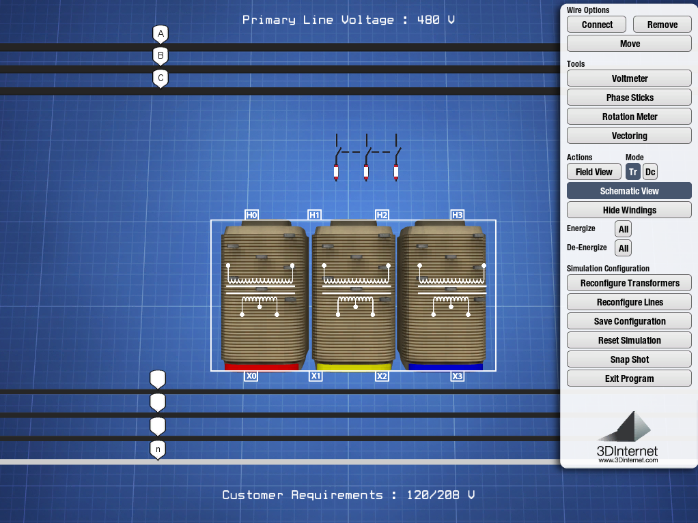
Dry-Type
Transformer
Trainer
`

Slide 54
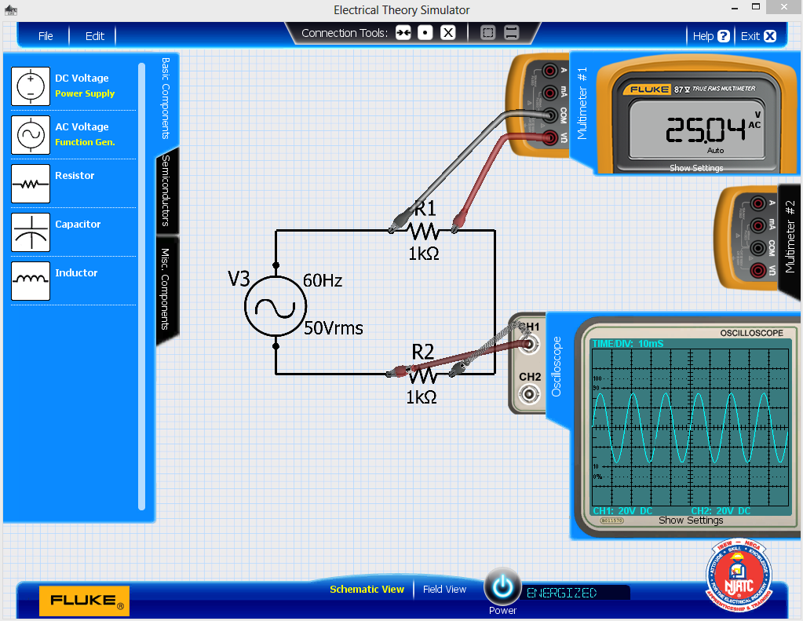
Electronic Trainer Simulator

Slide 56
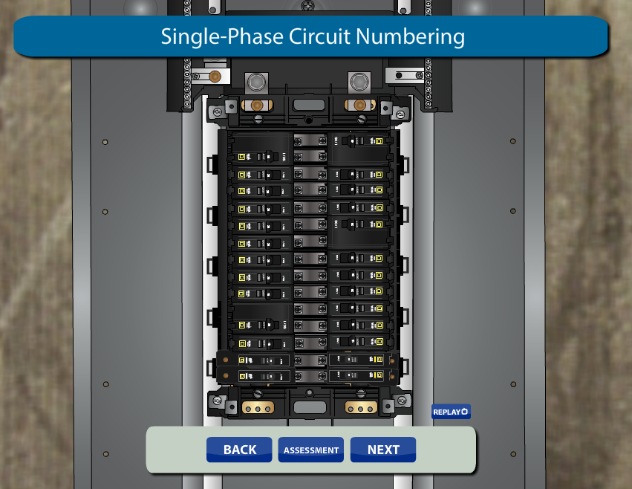

Slide 59
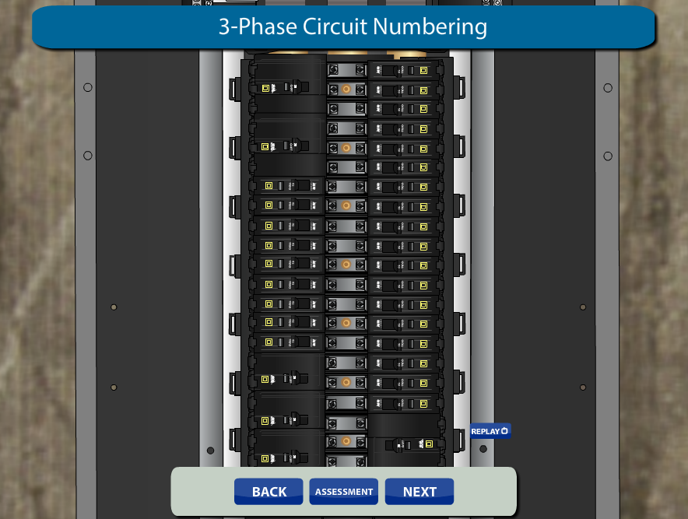

Slide 61
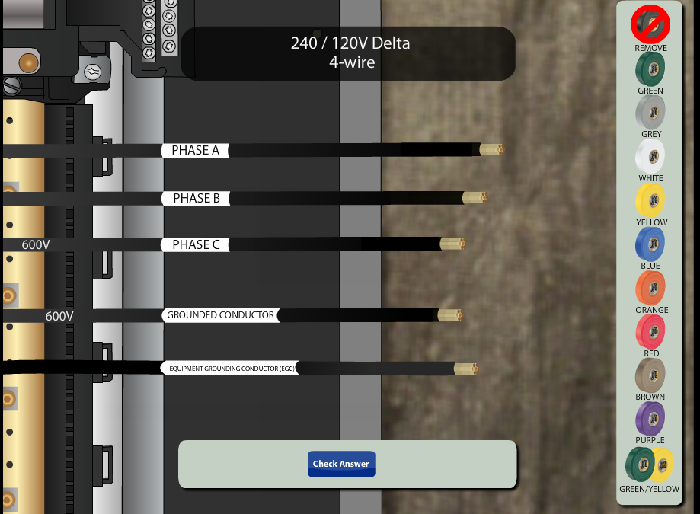

Slide 66
Resistance – Reciprocal
Resistance – Resistors of Equal Values

Slide 67
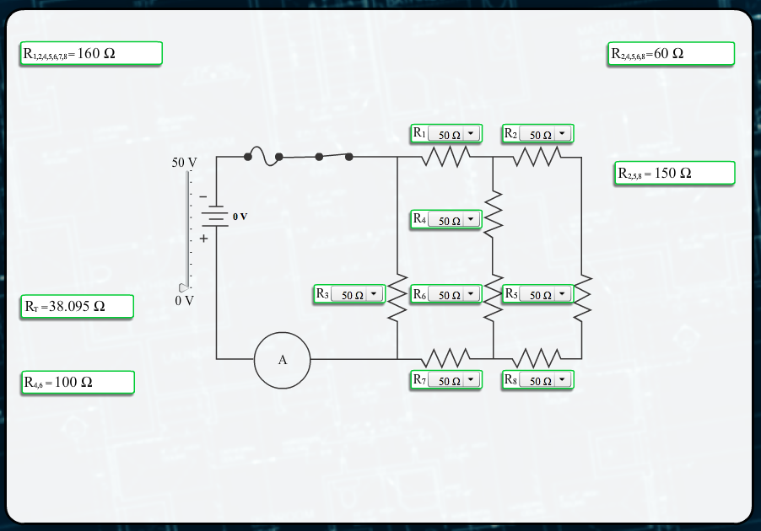
Total Resistance

Slide 68
Combination Currents

Slide 69
Combination Power

Slide 70
Voltage Drops

Slide 71
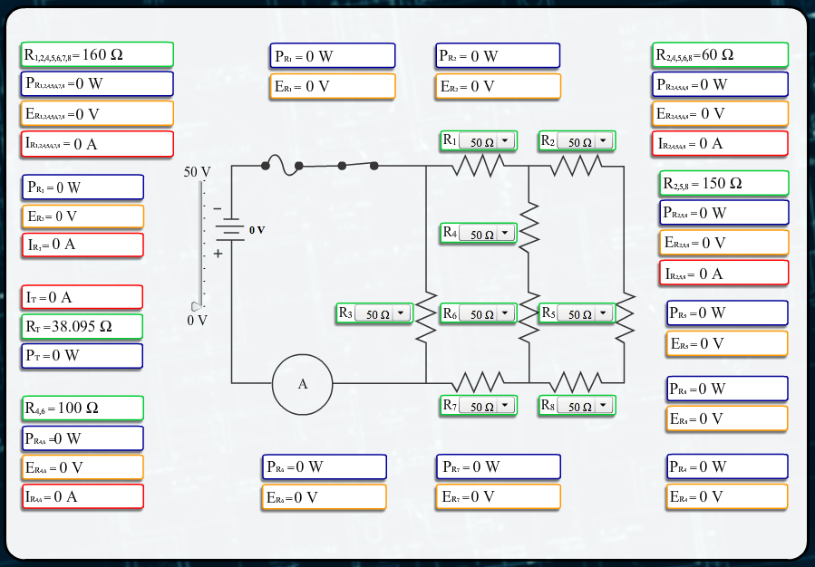
The Whole Enchilada

Slide 72
What’s the Future Job Description
For the Instructor?

Slide 73
Subject Matter Expert & Educator
…and comfortable with technology
1
NTI Training: Electrical Knowledge; Teaching Techniques
2
Implementation of lesson plan based on apprentices’ formative and summative assessments
3
OJT training with virtual and real world labs
4
Workforce Development (Human Resources Strategy)

Slide 74
Subject Matter Expert & Educator
…and comfortable with technology
5
Adult Learning & Career Building
6
Not only Knowledgeable, but great instructor
7
Understanding of Curriculum (Entire Overview)
8
Understanding of Instructional Design & Delivery – Active Learning Environment

Slide 75
LMS Savvy
Thorough understanding of LMS and all interactive components
Willing to utilize the reports of the LMS and development of customized lesson plans
Constant trek into technology and how the current generation embraces it.

Slide 76
CET
Continuing Electrical Training

Slide 78
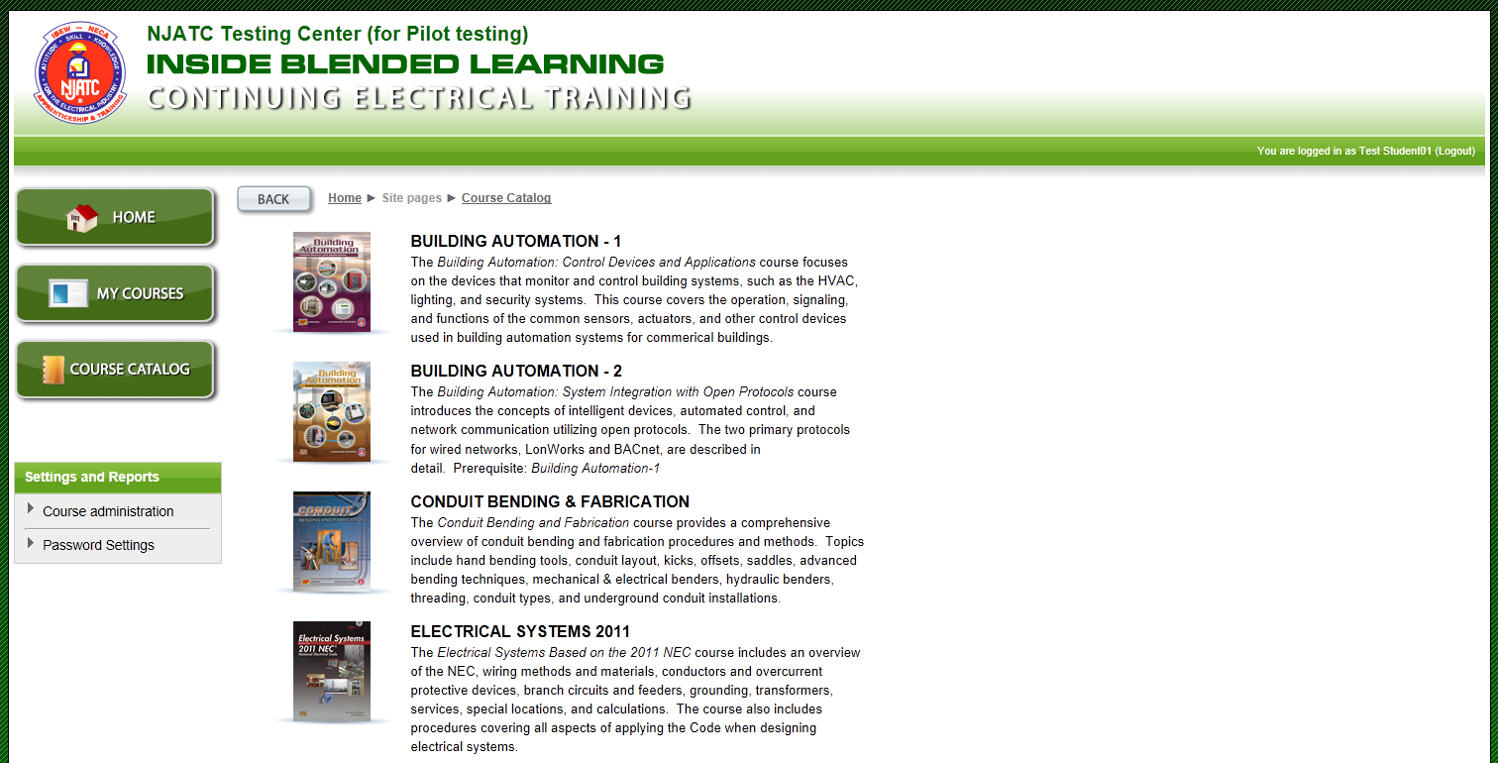
Electrical Safety Simulator

Slide 79
CET Courseware Update
CET Courses (Soft Skills)
Crossing the Line: Professional Personal Conduct
Every Hour Counts: Productivity Increases
First Impressions: The Power of Personal Appearance
Fiscally Fit? The Challenges of the Marketplace
Glass Houses: Ethical Behavior
Press One for Service: Meeting the Customer’s Needs
Something’s Fishy: Absenteeism
Time is Money: Productivity

Slide 80
What the Industry must achieve
Interactive Technologies to substantially increase successful training
Competency Training
Customized Training
Soft Skills Training
Certifications
Technology Savvy Workforce
Understanding how the next generation of workers utilize technology in learning
00-B

Slide 82
BILL PRESENTATION
How Do JATCs get on and log-on to the LMS
Notes:
This is just a slide to indicate the beginning of a section…….It MUST stay hidden…..

Slide 83
To: blendedlearning@njatc.org
From: <TD Name> ← The Training Director’s name. The TD will have the ability to set up assistants once logged on to the LMS
(A)JATC: <XXxxxx> ←Your training center ID; i.e. TX0255, or other ID Tag
Training Center Type: <JATC (Inside); AJATC (Outside); Utility Training
Training Center Name: <List the name of the training center as you wish it to appear across the top of the LMS home page>
Phone Numbers: (o) xxx-xxx-xxxx; (c) xxx-xxx-xxxx ←Both office and cell phone
Subject: LMS Account request for CET courses
Request for an LMS account to start using the CET courses.
My email is: xxxxxx@xxxxx.xxxx ←Your email will also be your username
My password should be: xxxxxxxxxxx ←Make up your own password, be sure to use a minimum of 8 letters with one number& one symbol character. i.e. 8frog%face8.

Slide 84
http://lmsadmin.njatc.org
Username
Password

Slide 85
http://lmsadmin.njatc.org
00

Slide 86
BILL PRESENTATION
What do the Administration Home Page Buttons Do?
Notes:
This is just a slide to indicate the beginning of a section…….It MUST stay hidden…..

Slide 99
00

Slide 100
BILL PRESENTATION
Preparing for Blended Learning
Notes:
This is just a slide to indicate the beginning of a section…….It MUST stay hidden…..

Slide 101
Point A to B
Instructor Training

Slide 102
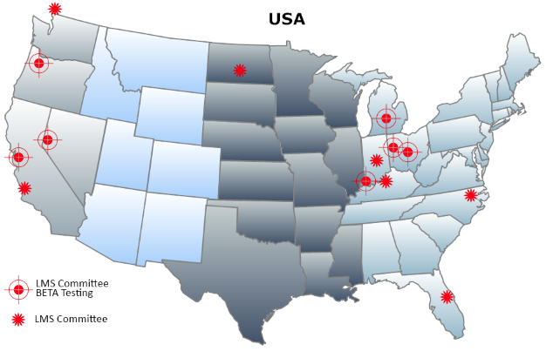
BETA Testing
√
BETA for 2013

Slide 103
Timeline
(2014 - 2018)
Implement
1st Year
(9/1/14)
Implement 3rd year
(9/1/16)
Implement
5th year
(9/1/18)
Implement
2nd year
(9/1/15)
Implement 4th year
(9/1/17)

Slide 104
Timeline
(Now to Fall of 2014)
CET Courses
Webinars & Bulletins
Instructor LMS Course and Instructor Portal
NTI and TD Conferences
2013/2014 BLAST Tours
(TD & Lead LMS Instructors)
In-house localized training with lead JATC Instructor

Slide 105
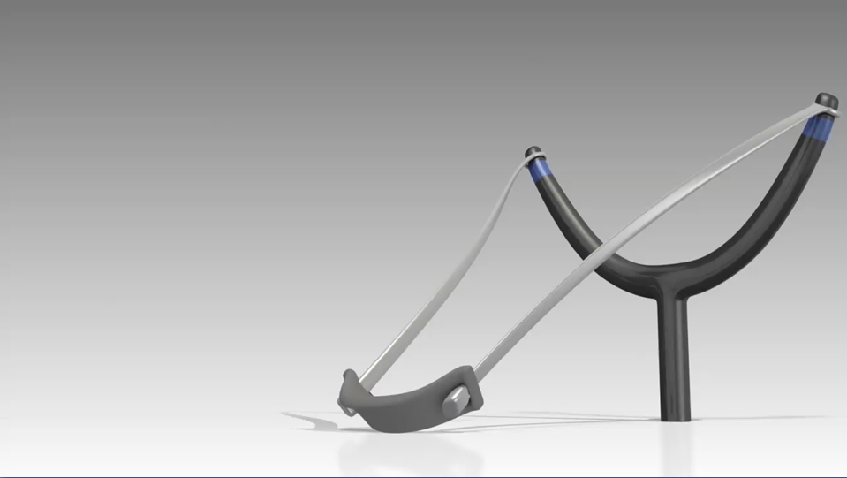
Preparing to Launch
Webcasts

Slide 106
Monthly Webcast
Hosted by Bill Ball

Slide 107
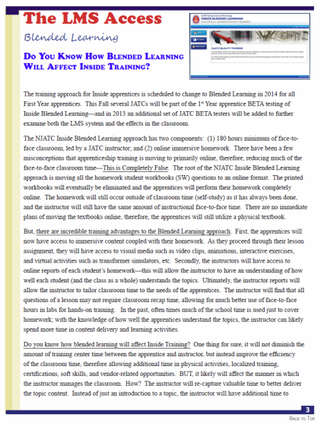
Monthly Bulletins

Slide 108
Check List
Request JATC LMS Activation
Review the LMS Functionality Videos
Install WiFi throughout building
Local Marketing for CET Courses
Read the Monthly LMS Articles
Attend Monthly LMS Webcasts
Schedule Instructors to NTI
Attend BLAST-2 Tour
Instructor Course
Changes to Policies

Slide 109
http://www.njatc.tv/blendedlearning.html

Slide 110
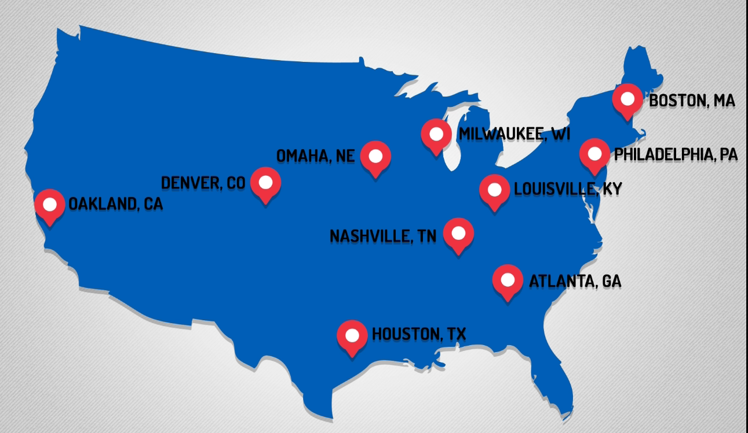
BLAST TOUR-II
Active Learning Classroom
Notes:
Spreading the good news will become active in 2012, especially in the Marketing arena. 2013-2014 will be the years where the NJATC will go on the road (East, Central, & West) several times to hold local training events. These events will train the JATC staff and instructors….much like the Outside Road show a few years back.

Slide 111
The Instructor
Blended Learning Course

Slide 112
PHASE-I
Module 1: Course Introduction
Module 2: Basic Computer Skills
Module 3: Blended Learning
Module 4: LMS Navigation
Module 5: Course Enhancements
Module 6: Reports (Instructors)
Module 7: Blending in the LMS
Module 8: Enrollment (Instructors)
Module 9: Submitting Errata and LMS Help
Module 10: Enrollment (Training Directors)
Module 11: Reports (Training Directors)
Module 12: CCW (Training Directors)
Instructorportal.njatc.org

Slide 121
Notes:
002.jpgThis slide represents a visual story being presented to the student. Each topic, where appropriate, will coincide with a story to that illustrates the topic being discussed. Here is the audio narration planned for this slide to help you visualize it. (Keep in mind this slide will be an animated presentation.)Narration: This is Bill, a full-time foreman and part-time JATC instructor. It’s late August, and Bill needs to start thinking about teaching again, in between managing his crew, troubleshooting problems on the job site, spending time with his family, and, of course, gearing up for the football season—Bill is a HUGE football fan. Luckily for Bill, the NJATC Blended learning LMS makes preparing for teaching a little easier. It collects a lot of instructional information in one place , which he can quickly review.

Slide 122
Notes:
001.jpgThis is an introduction slide with a video presenter shot on green-screen. He will introduce the topic, it's learning objectives, and other details about the section of the training to level-set the student.

Slide 123
Notes:
003.jpgThis slide is a continuation of the previous where we begin to visually illustrate how Bill interacts with the LMS.

Slide 124
Notes:
004.jpgThis slide is another example of telling a story graphically to the student that will correlate with actions performed in the LMS. Again, we are mapping technical operations within the LMS to real world needs of the instructors/training directors by mapping tasks performed in the LMS to stories that illustrate needs of NJATC instructors / TD's.

Slide 125
Notes:
005.jpgThis comp shows you two slides that illustrate how we will *show* the student how a process is done. We will animate the process being performed as in the last side, we will walk the student through the process with guidance, then on the next slide (006.jpg) we will have the student perform the task without the guidance.

Slide 126
LIVE
Notes:
007.jpgOur on-screen talent will review the topic just covered, discuss important items in conclusion, and guide the student to their next action.

Slide 127
BILL PRESENTATION
Q&A at the end
Notes:
This is just a slide to indicate the beginning of a section…….It MUST stay hidden…..

Slide 128
How does the Core Curriculum
relate to LMS?

Slide 129
Core Curriculum Structure
90 CREDITS OF CORE
1st Year Core
2nd Year Core
3rd Year Core
4th Year Core
5th Year Core
1st Year Core
30 Credits w/Applications
2nd Year Core
25 Credits w/Applications
3rd Year Core
15 Credits
4th Year Core
10 Credits
5th Year Core
10 Credits
Building a Foundation in Mathematics
Optional
Orientation 1
2 Credits
Orientation 2
1 Credit
AC Theory 2
3 Credits
Blueprints 3
1 Credit
Code & Prac. 4
2 Credits
Job Info. 1
6 Credits
Test Inst. 1
2.5 Credits
Transformer 2
2 Credits
Code Calc. 1
1 Credit
Orientation 3
1 Credit
Conduit 1
3 Credits
Codeology 1
3 Credits
Electrical Safe Work Practices 2
2 Credits
Grounding & Bonding 2
2.5 Credits
Code Calc. 2
1.5 Credits
Optional
Boot Camp
(40-hr Design)
Before Work
DC Theory 1
10 Credits
AC Theory 1
7 Credits
Code & Prac. 3
2 Credits
Motor Ctrl. 1
3.5 Credits
Motor Ctrl. 2
4 Credits
Code & Prac. 1
4 Credits
Blueprints 1
2.5 Credits
Blueprints 2
2 Credits
Motors 1
2 Credits
Torque 1
0.5 Credit
Conduit 2
4 Credits
Electrical Safe Work Practices 1
2 Credits
Fire Alarm 1
2 Credits
Rigging 1
1 Credit
Boot Camp
in the 1st Year
Transformer 1
2 Credits
Grounding & Bonding 1
2 Credits
4th Year Advanced
15 Credits
5th Year Advanced
15 Credits
Ind. Awareness
in the 1st Year
Code & Prac. 2
4 Credits
15 Credits of
JATC Selected Advanced
Courses
15 Credits of
JATC Selected Advanced
Courses
3rd Year Advanced
10 Credits
Optional
Application
1/4 Credit
Application
1/4 Credit
10 Credits of
JATC Selected Advanced
Courses
Industry Awareness
(40-hr Design)
Before Work
Application
1/4 Credit
Application
1/4 Credit
Application
1/4 Credit
Application
1/4 Credit
40 CREDITS OF ADVANCED
Application
1/4 Credit
Application
1/4 Credit

Slide 130
Core Curriculum Structure
90 CREDITS OF CORE
1st Year Core
2nd Year Core
3rd Year Core
4th Year Core
5th Year Core
1st Year Core
30 Credits w/Applications
2nd Year Core
25 Credits w/Applications
3rd Year Core
15 Credits
4th Year Core
10 Credits
5th Year Core
10 Credits
Building a Foundation in Mathematics
Optional
Orientation 1
2 Credits
Orientation 2
1 Credit
AC Theory 2
3 Credits
Blueprints 3
1 Credit
Code & Prac. 4
2 Credits
Job Info. 1
6 Credits
Test Inst. 1
2.5 Credits
Transformer 2
2 Credits
Code Calc. 1
1 Credit
Orientation 3
1 Credit
Conduit 1
3 Credits
Codeology 1
3 Credits
Electrical Safe Work Practices 2
2 Credits
Grounding & Bonding 2
2.5 Credits
Code Calc. 2
1.5 Credits
Optional
Boot Camp
(40-hr Design)
Before Work
DC Theory 1
10 Credits
AC Theory 1
7 Credits
Code & Prac. 3
2 Credits
Motor Ctrl. 1
3.5 Credits
Motor Ctrl. 2
4 Credits
Code & Prac. 1
4 Credits
Blueprints 1
2.5 Credits
Blueprints 2
2 Credits
Motors 1
2 Credits
Torque 1
0.5 Credit
Conduit 2
4 Credits
Electrical Safe Work Practices 1
2 Credits
Fire Alarm 1
2 Credits
Rigging 1
1 Credit
Boot Camp
in the 1st Year
Transformer 1
2 Credits
Grounding & Bonding 1
2 Credits
4th Year Advanced
15 Credits
5th Year Advanced
15 Credits
Ind. Awareness
in the 1st Year
Code & Prac. 2
4 Credits
15 Credits of
JATC Selected Advanced
Courses
15 Credits of
JATC Selected Advanced
Courses
3rd Year Advanced
10 Credits
Optional
Application
1/4 Credit
Application
1/4 Credit
10 Credits of
JATC Selected Advanced
Courses
Industry Awareness
(40-hr Design)
Before Work
Application
1/4 Credit
Application
1/4 Credit
Application
1/4 Credit
Application
1/4 Credit
40 CREDITS OF ADVANCED
Application
1/4 Credit
Application
1/4 Credit

Slide 131
Core Curriculum Structure
90 CREDITS OF CORE
1st Year Core
2nd Year Core
3rd Year Core
4th Year Core
5th Year Core
1st Year Core
30 Credits w/Applications
2nd Year Core
25 Credits w/Applications
3rd Year Core
15 Credits
4th Year Core
10 Credits
5th Year Core
10 Credits
Building a Foundation in Mathematics
Optional
Orientation 1
2 Credits
Orientation 2
1 Credit
AC Theory 2
3 Credits
Blueprints 3
1 Credit
Code & Prac. 4
2 Credits
Job Info. 1
6 Credits
Test Inst. 1
2.5 Credits
Transformer 2
2 Credits
Code Calc. 1
1 Credit
Orientation 3
1 Credit
Conduit 1
3 Credits
Codeology 1
3 Credits
Electrical Safe Work Practices 2
2 Credits
Grounding & Bonding 2
2.5 Credits
Code Calc. 2
1.5 Credits
Optional
Boot Camp
(40-hr Design)
Before Work
DC Theory 1
10 Credits
AC Theory 1
7 Credits
Code & Prac. 3
2 Credits
Motor Ctrl. 1
3.5 Credits
Motor Ctrl. 2
4 Credits
Code & Prac. 1
4 Credits
Blueprints 1
2.5 Credits
Blueprints 2
2 Credits
Motors 1
2 Credits
Torque 1
0.5 Credit
Conduit 2
4 Credits
Electrical Safe Work Practices 1
2 Credits
Fire Alarm 1
2 Credits
Rigging 1
1 Credit
Boot Camp
in the 1st Year
Transformer 1
2 Credits
Grounding & Bonding 1
2 Credits
4th Year Advanced
15 Credits
5th Year Advanced
15 Credits
Ind. Awareness
in the 1st Year
Code & Prac. 2
4 Credits
15 Credits of
JATC Selected Advanced
Courses
15 Credits of
JATC Selected Advanced
Courses
3rd Year Advanced
10 Credits
Optional
Application
1/4 Credit
Application
1/4 Credit
10 Credits of
JATC Selected Advanced
Courses
Industry Awareness
(40-hr Design)
Before Work
Application
1/4 Credit
Application
1/4 Credit
Application
1/4 Credit
Application
1/4 Credit
40 CREDITS OF ADVANCED
Application
1/4 Credit
Application
1/4 Credit

Slide 132
E-books and where we are
headed with them?

Slide 133
How soon will we have access to the
1st year courses, to review it
before we have to teach?

Slide 134
1
I would like to know more of a cost breakdown

Slide 136
Information on the virtual boot camp & Custom Courseware

Slide 138
What kind of device
will run the LMS?

Slide 139
Windows Computer
15“ HD LED-Backlit Wide Screen Display
Dual-Core Core minimum
4GB RAM
Sound
Camera (optional)
BlueRay; DVD/CDR Combo Drive (optional)
HD Graphics (Integrated Graphics)
Wireless
Microsoft Windows 7 or 8
Internet Explorer

Slide 140
Blended Learning
For Apprenticeship & CET & CET

