Slide 2
…a week of
Blended Learning…

Slide 3
Jim is the Instructor
Notes:
Bill Ball Slide

Slide 4
Next Week
DC Theory: Lesson 22
Understanding Resistance in DC Combination Circuits
Combination Circuits
Require the use of earlier skills
Series Resistors
Parallel Resistors
May be solved using skill which you already have demonstrated
Example
INSTRUCTOR
Notes:
Jim Boyd Slide

Slide 5
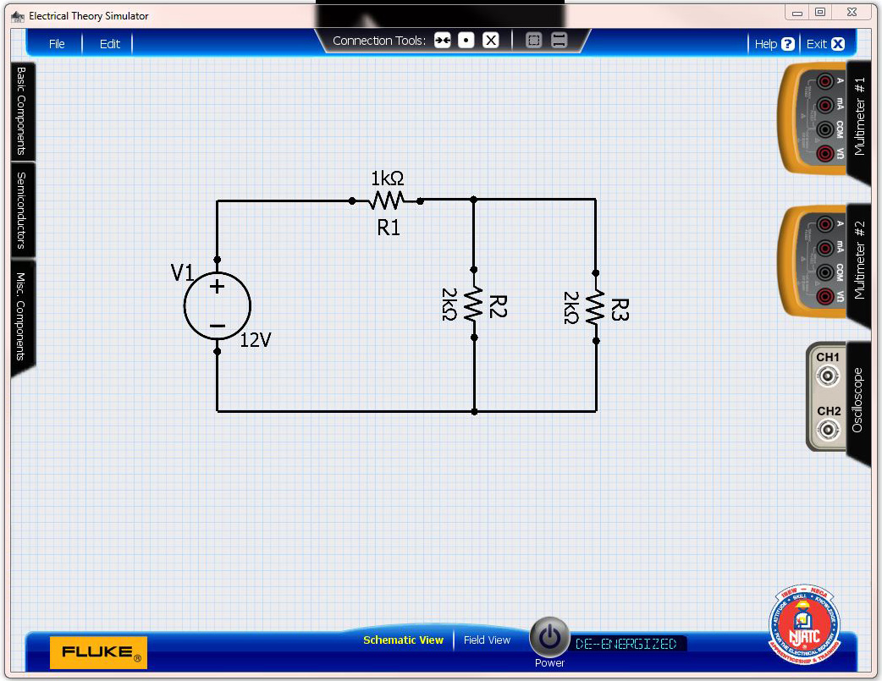
RT = ?
INSTRUCTOR
Notes:
Jim Boyd Slide

Slide 6
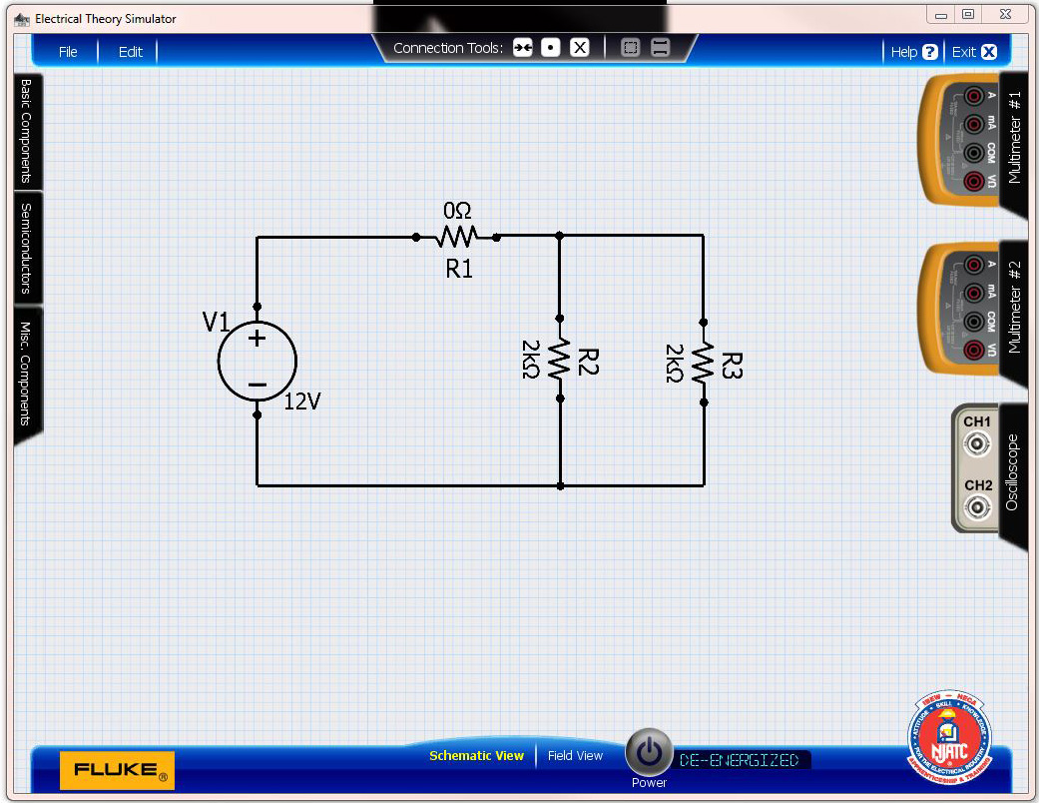
Assume R₁ = 0 Ω
R_{T} = ?
INSTRUCTOR
Notes:
Jim Boyd Slide

Slide 7
New Circuit
R_{T} = ?
INSTRUCTOR
Notes:
Jim Boyd Slide

Slide 8
Solve for R₂ and R₃ in Parallel
R_{T} = (R₂ x R₃) / (R₂ + R₃)
R_{T} = 2,000 x 2,000 = 1,000 Ω
2,000 + 2,000
INSTRUCTOR
Notes:
Jim Boyd Slide

Slide 9
Add R₁ back into the circuit
R_{T} = ?
INSTRUCTOR
Notes:
Jim Boyd Slide

Slide 10
Solve R₁ and R₂₃ in Series
R_{T} = R₁ + R₂₃
R_{T} = 1,000 + 1,000 = 2,000 Ω
INSTRUCTOR
Notes:
Jim Boyd Slide

Slide 11
Prove the calculation by removing the Power Source and measuring the resistance in the original combination circuit
INSTRUCTOR
Use Combination Circuit 22a
Notes:
Jim Boyd Slide

Slide 12
Reminder:
Next Class Assignment: DC Theory Lesson 22
HINT: Use the simulator to verify quizzes
Homework is due Sunday before 8:00 PM
If you have questions, you may email me before Friday at 9:00 PM and I will respond to all emails within 24 hours. ( jeanwilliams@njatc.org )
INSTRUCTOR
Notes:
Jim Boyd Slide

Slide 13
Bill is an Apprentice
Notes:
Jim Boyd Slide

Slide 14
BlendedLearning.NJATC.org
APPRENTICE
Notes:
Bill Ball Slide

Slide 15
joseallen@njatc.org
****************
APPRENTICE
Notes:
Bill Ball Slide

Slide 16
APPRENTICE
Notes:
Bill Ball Slide

Slide 17
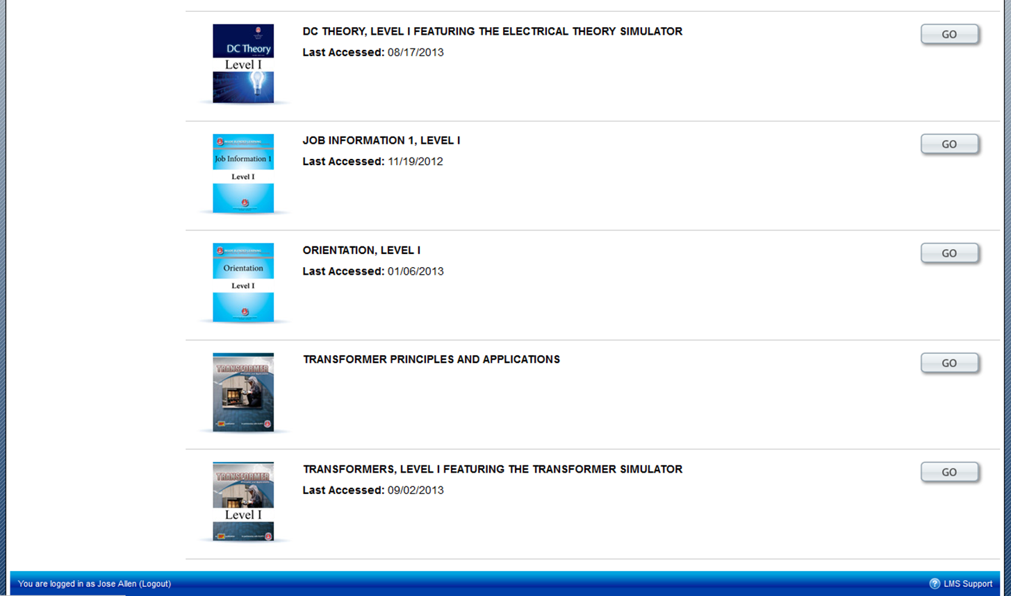
APPRENTICE
Notes:
Bill Ball Slide

Slide 18
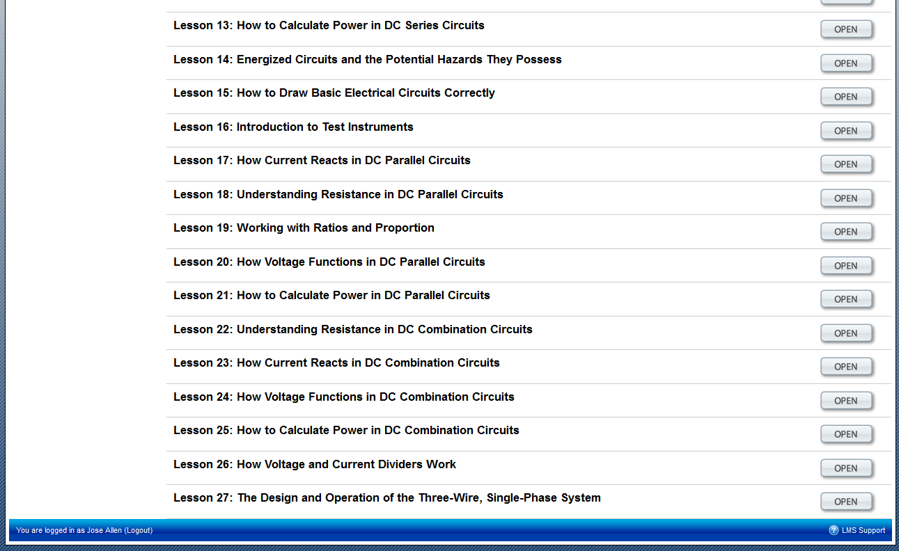
APPRENTICE
Notes:
Bill Ball Slide

Slide 19
APPRENTICE
Notes:
Bill Ball Slide

Slide 20
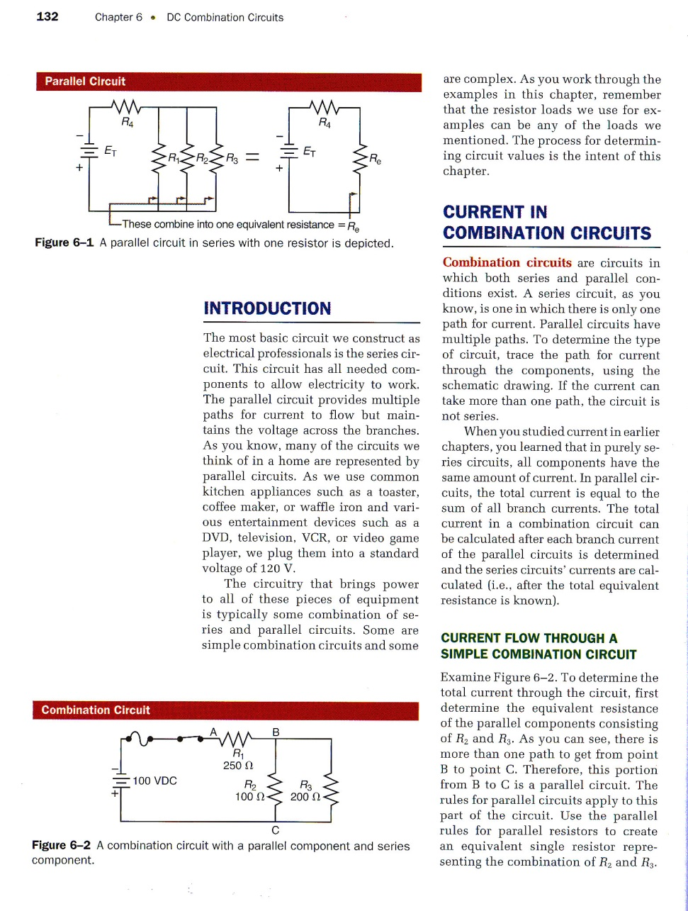
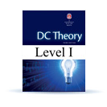
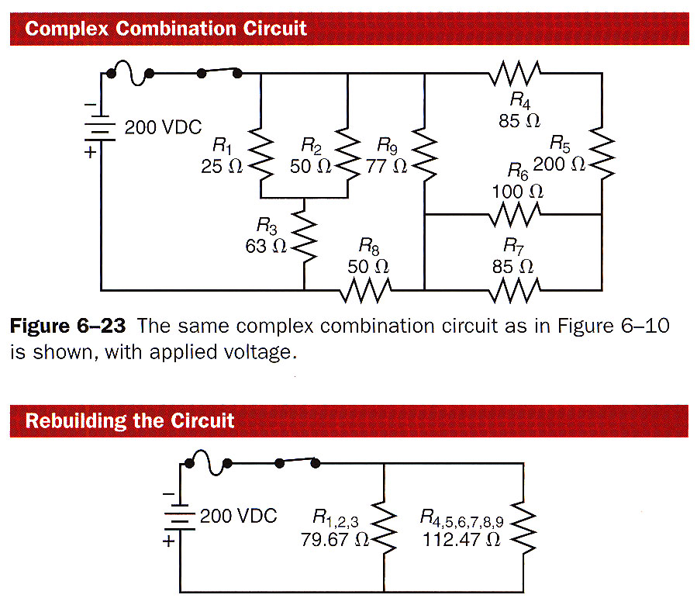
DC Theory
Textbook
APPRENTICE
Notes:
Bill Ball Slide

Slide 21
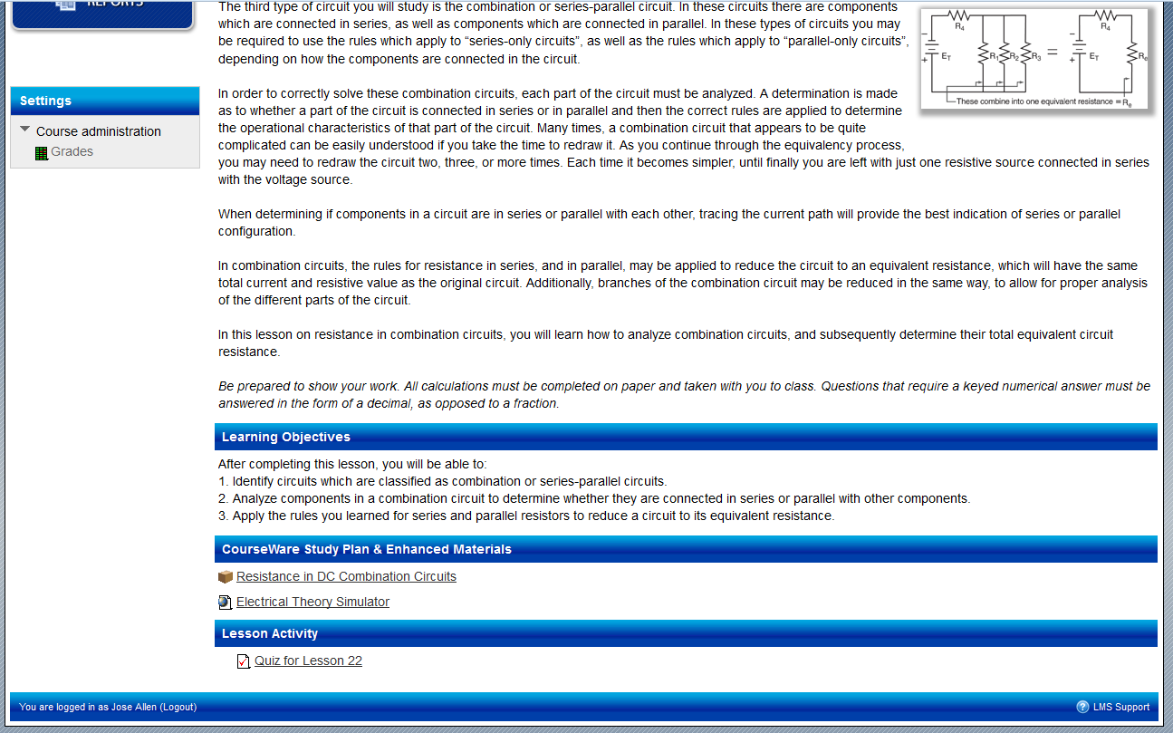
APPRENTICE
Notes:
Bill Ball Slide

Slide 22
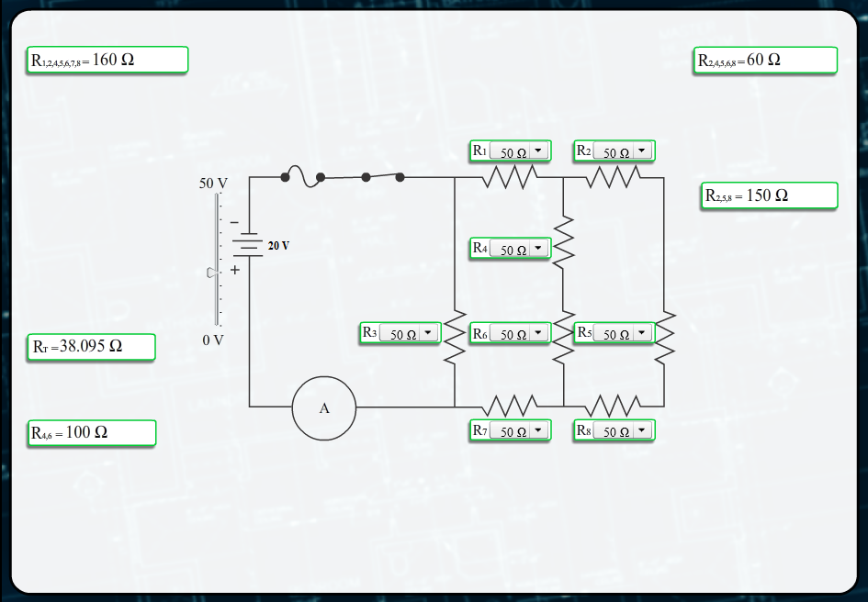
APPRENTICE
Notes:
Bill Ball Slide

Slide 23
APPRENTICE
Notes:
Bill Ball Slide

Slide 24
APPRENTICE
Notes:
Bill Ball Slide

Slide 25
APPRENTICE
Notes:
Bill Ball Slide

Slide 26
APPRENTICE
Notes:
Bill Ball Slide

Slide 27
???
APPRENTICE
Notes:
Bill Ball Slide

Slide 28
Dear Ms. Williams
Question 21-24 in this week’s lesson do not have values for the resistors. Are we supposed to use the values from Question 20 in these questions?
Thanks,
Jose Allen
Notes:
Bill Ball Slide

Slide 29
Jim is the Instructor
Notes:
Bill Ball Slide

Slide 30
INSTRUCTOR
Notes:
Jim Boyd Slide

Slide 31
INSTRUCTOR
Notes:
Jim Boyd Slide

Slide 32
Bill is an Apprentice
Notes:
Jim Boyd Slide

Slide 33
APPRENTICE
Notes:
Bill Ball Slide

Slide 34
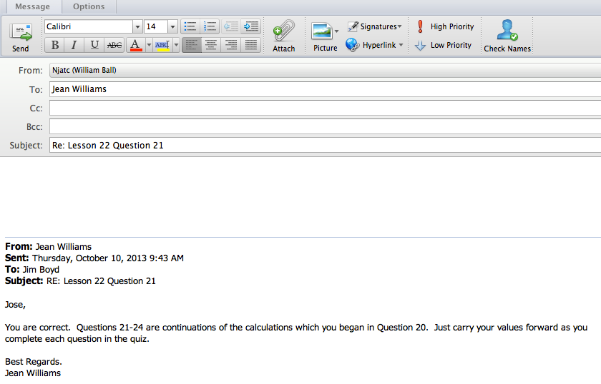
Ms. Williams:
Thanks for the reply.
Jose
APPRENTICE
Notes:
Bill Ball Slide

Slide 35
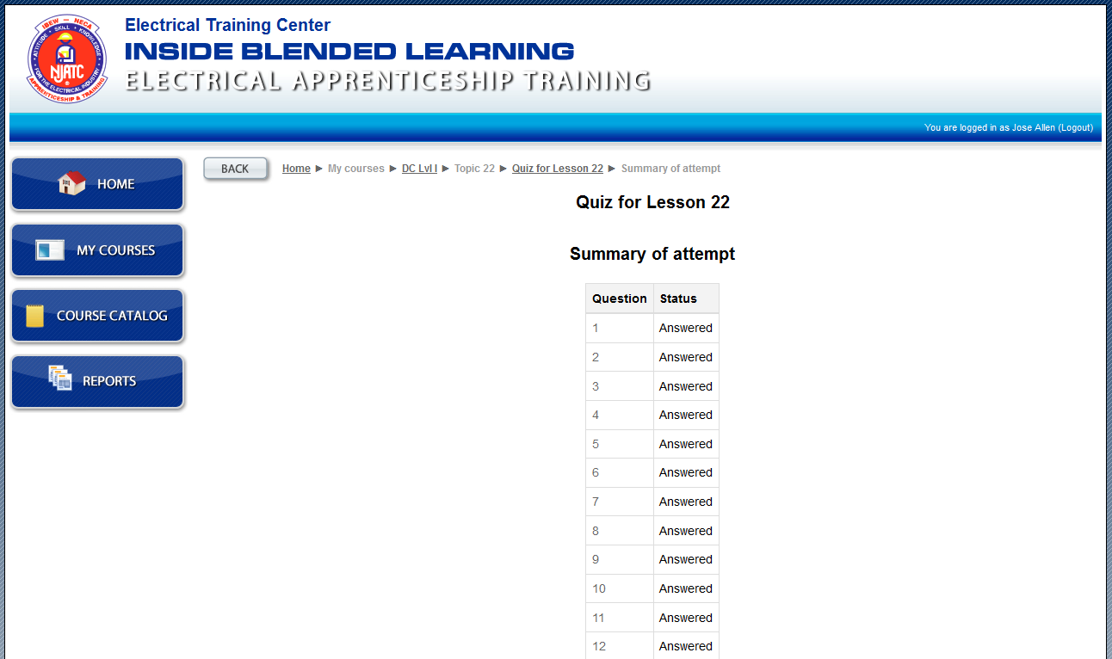
APPRENTICE
Notes:
Bill Ball Slide

Slide 36
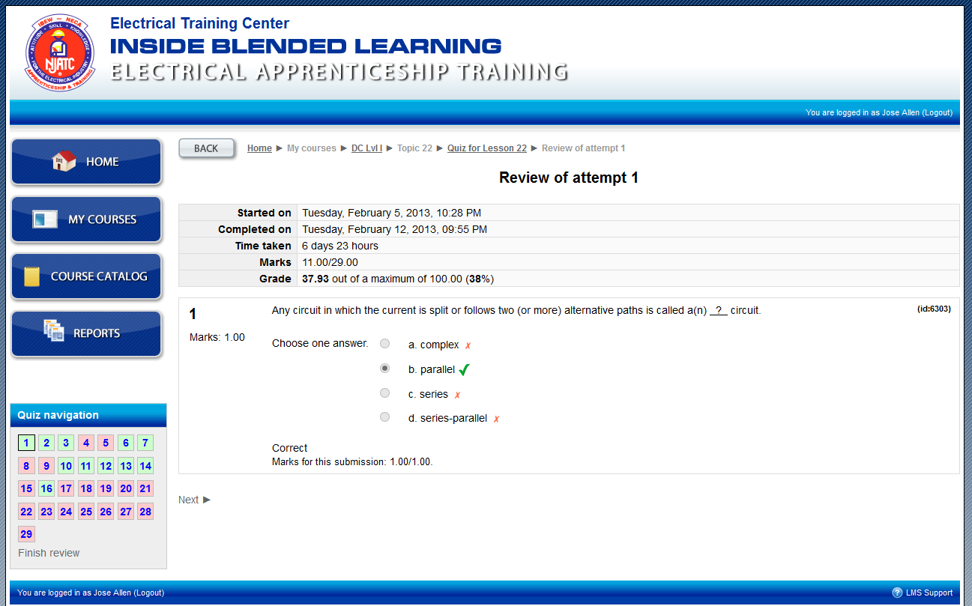
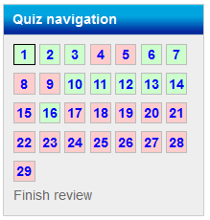
APPRENTICE
Notes:
Bill Ball Slide

Slide 37
DC Theory
Textbook
APPRENTICE
Notes:
Bill Ball Slide

Slide 38
Jim is the Instructor
Notes:
Bill Ball Slide

Slide 39
INSTRUCTOR
Notes:
Jim Boyd Slide

Slide 40
INSTRUCTOR
Notes:
Jim Boyd Slide

Slide 41
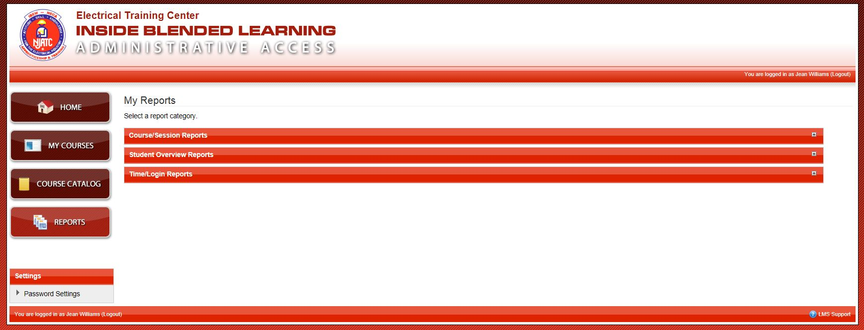
INSTRUCTOR
Notes:
Jim Boyd Slide

Slide 42
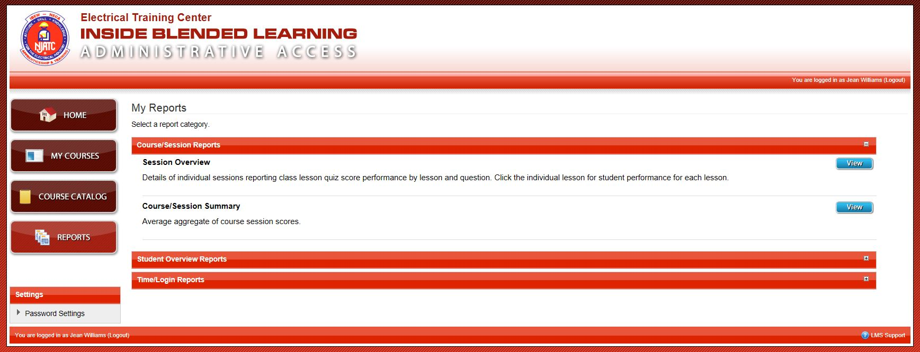
INSTRUCTOR
Notes:
Jim Boyd Slide

Slide 43
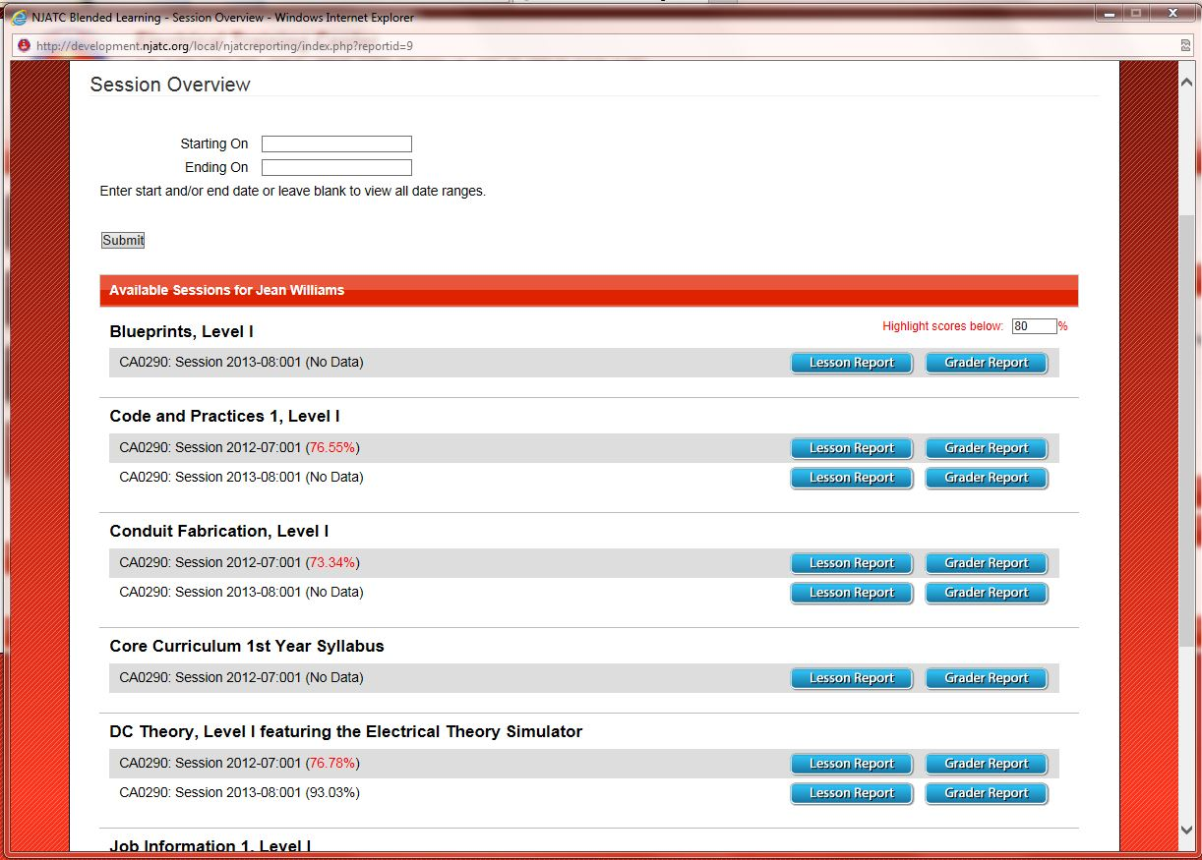
Notes:
Jim Boyd Slide

Slide 44
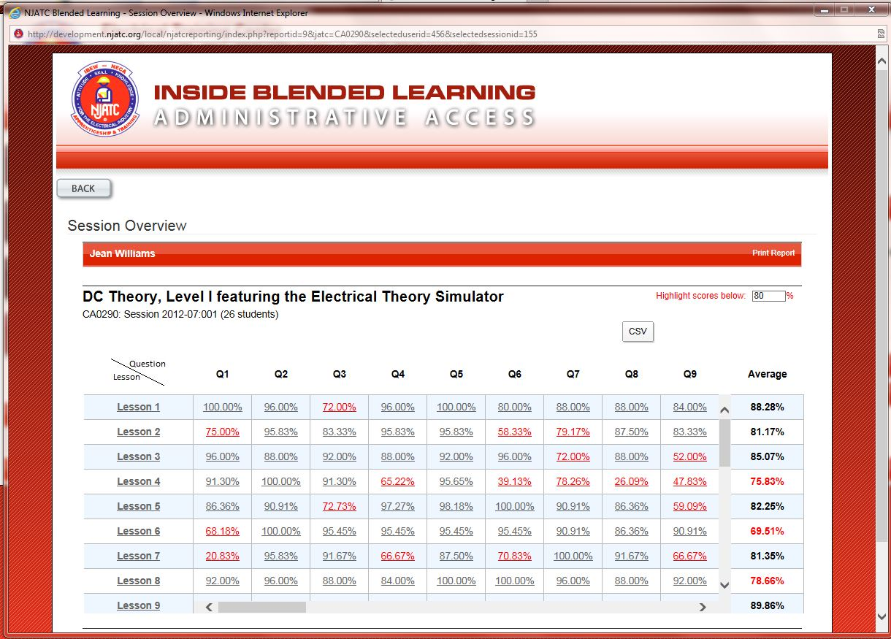
Notes:
Jim Boyd Slide

Slide 45
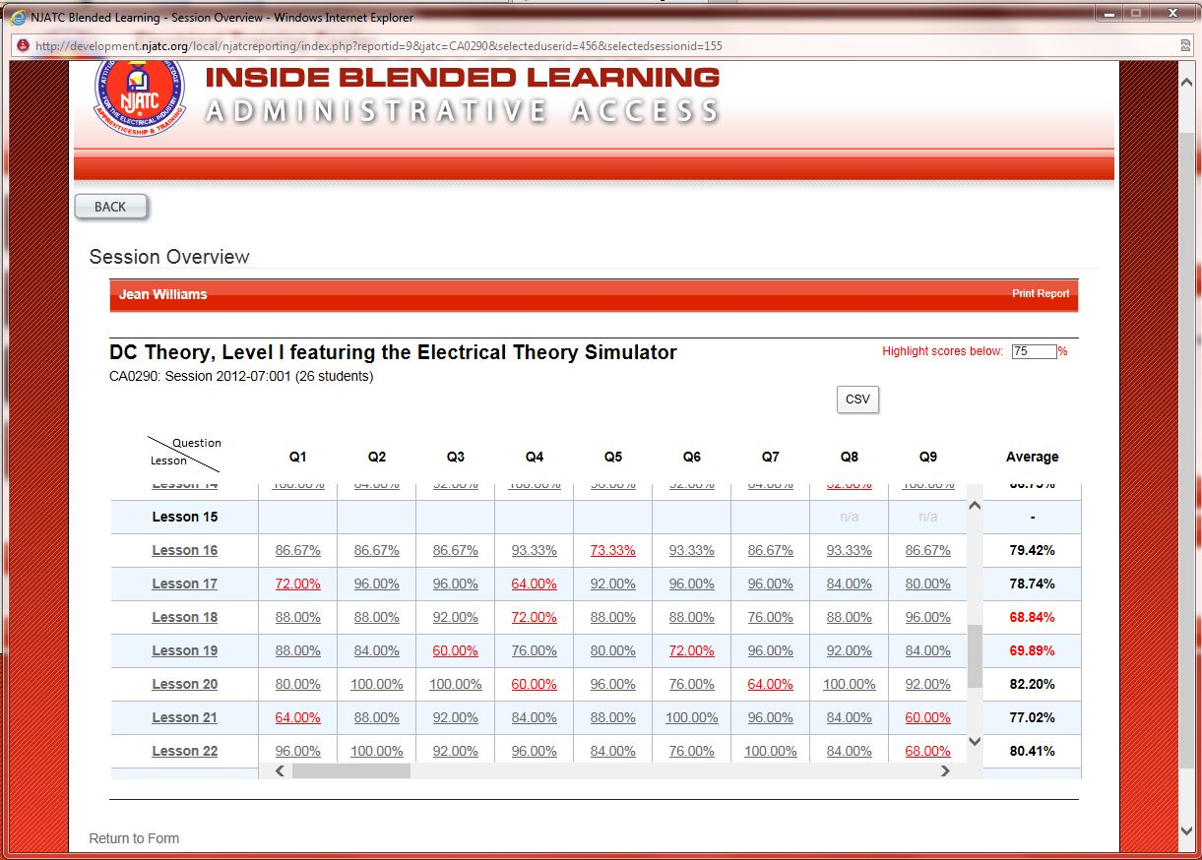
Notes:
Jim Boyd Slide

Slide 46
LESSON 22
Question 9 – 68%
Question 15 – 72%
Question 19 – 64%
Question 21 – 72%
Question 22 – 60%
Question 23 – 68%
Question 24 – 64%
Question 26 – 68%
Question 27 – 72%
Question 28 – 72%
Question 29 – 44%
INSTRUCTOR
Notes:
Jim Boyd Slide

Slide 47
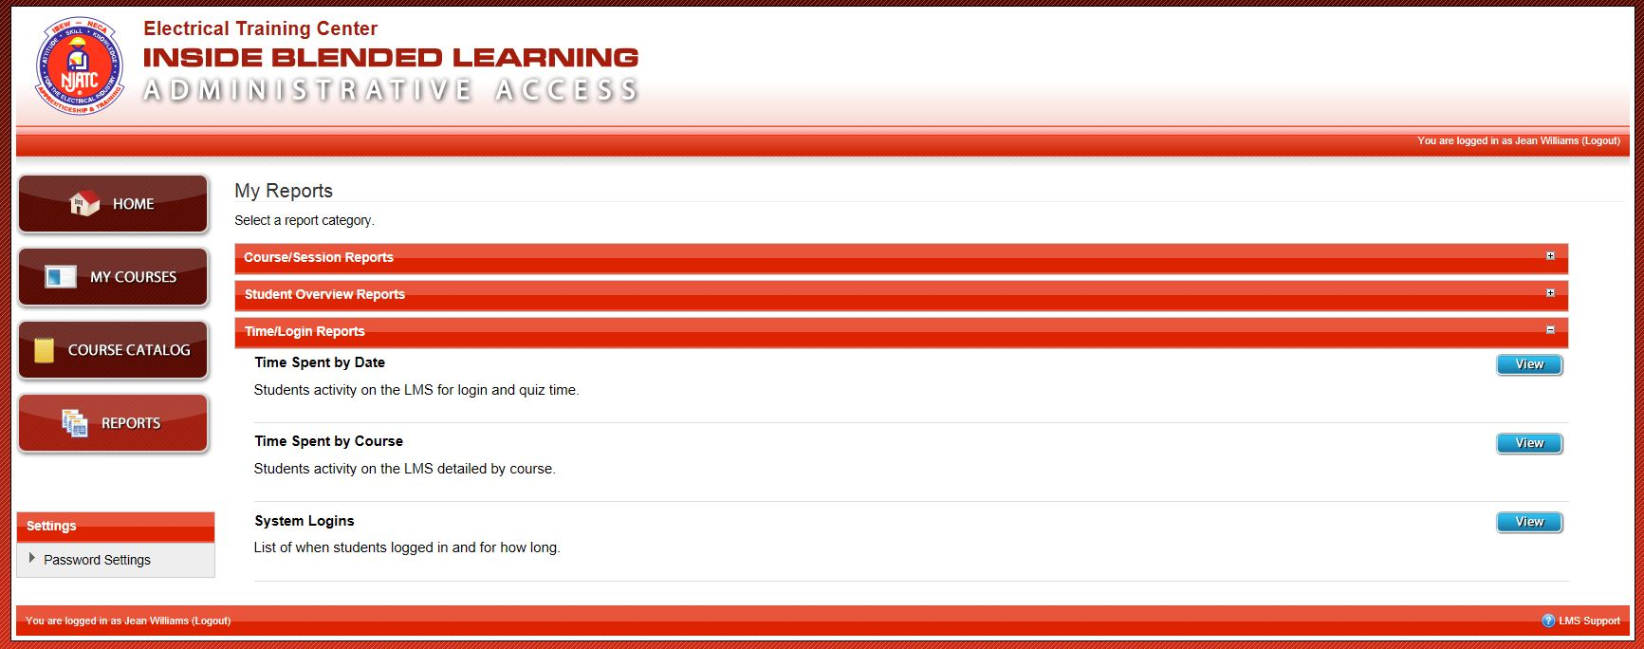
INSTRUCTOR
Notes:
Jim Boyd Slide

Slide 48
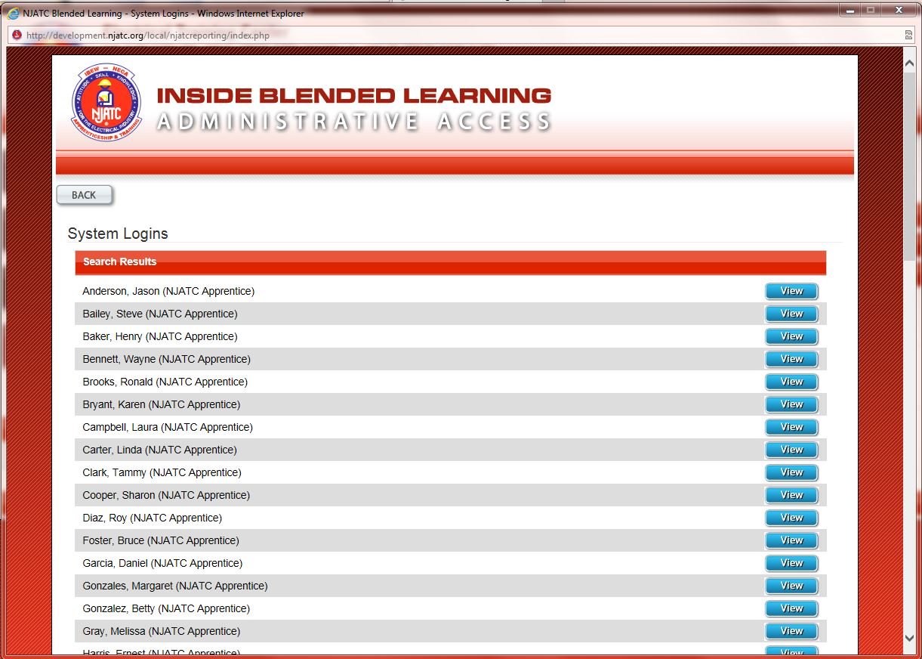
Notes:
Jim Boyd Slide

Slide 49
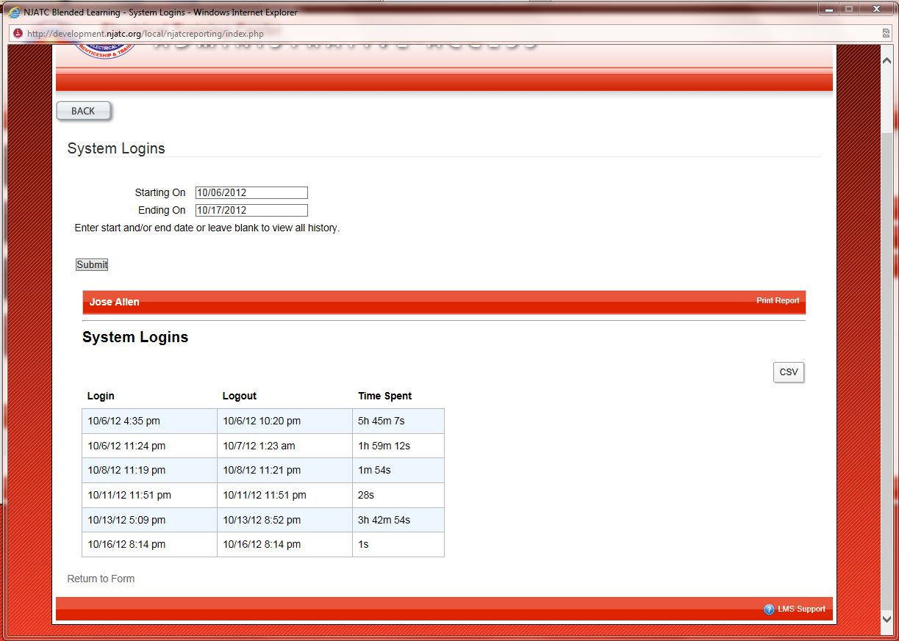
Notes:
Jim Boyd Slide

Slide 50
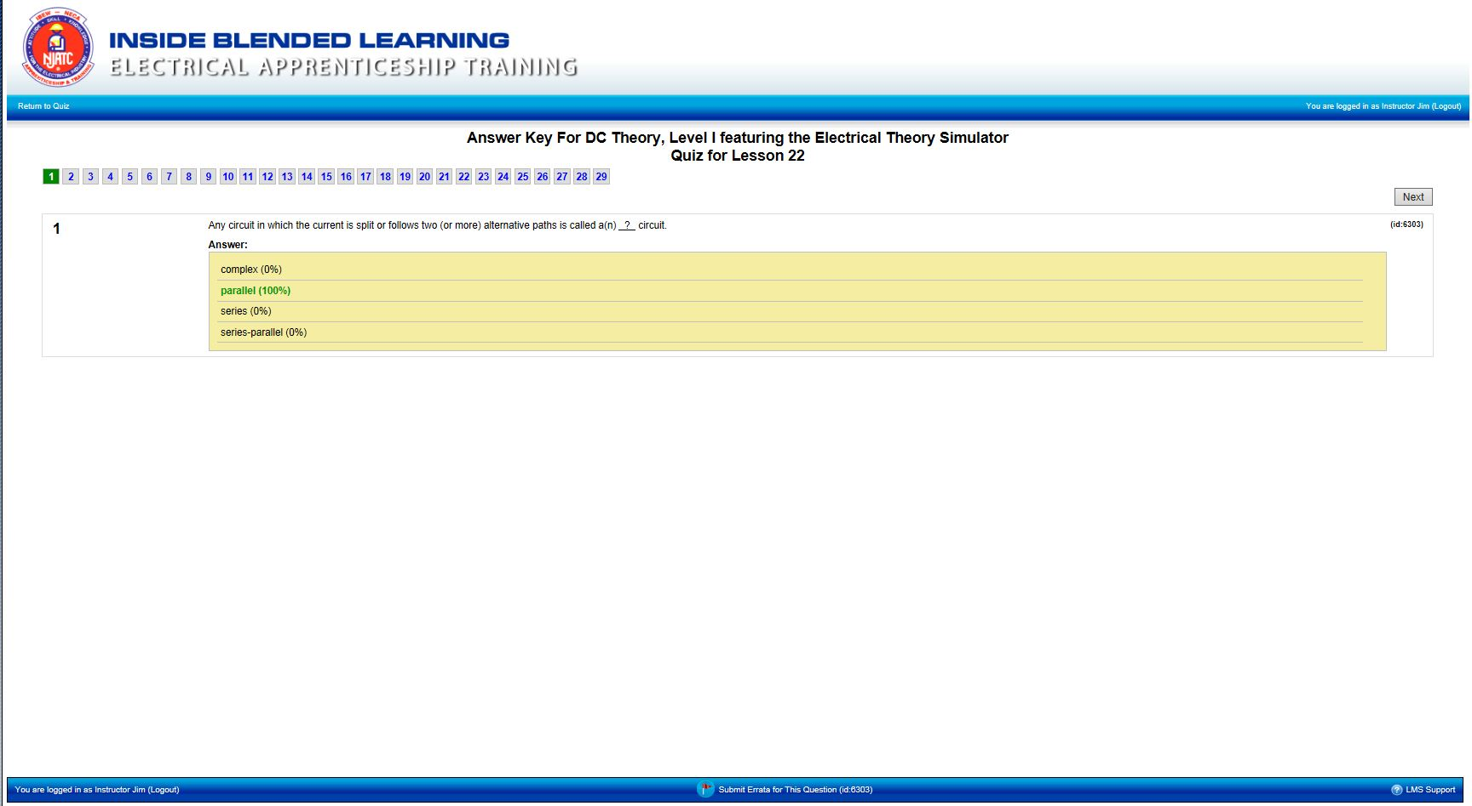
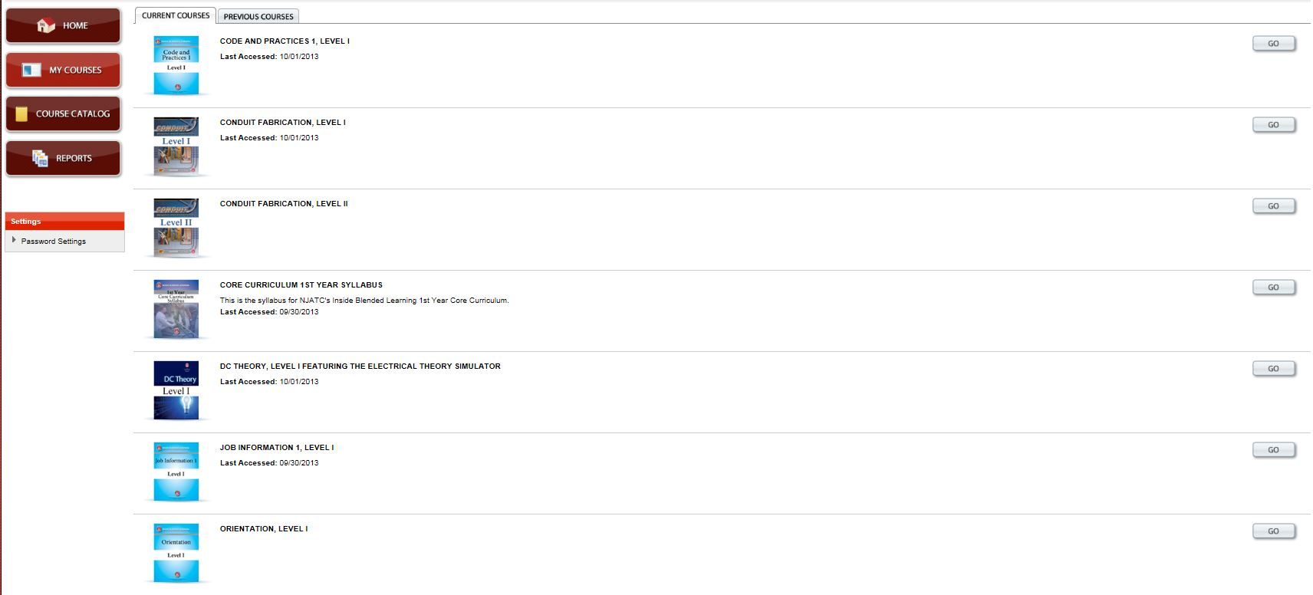
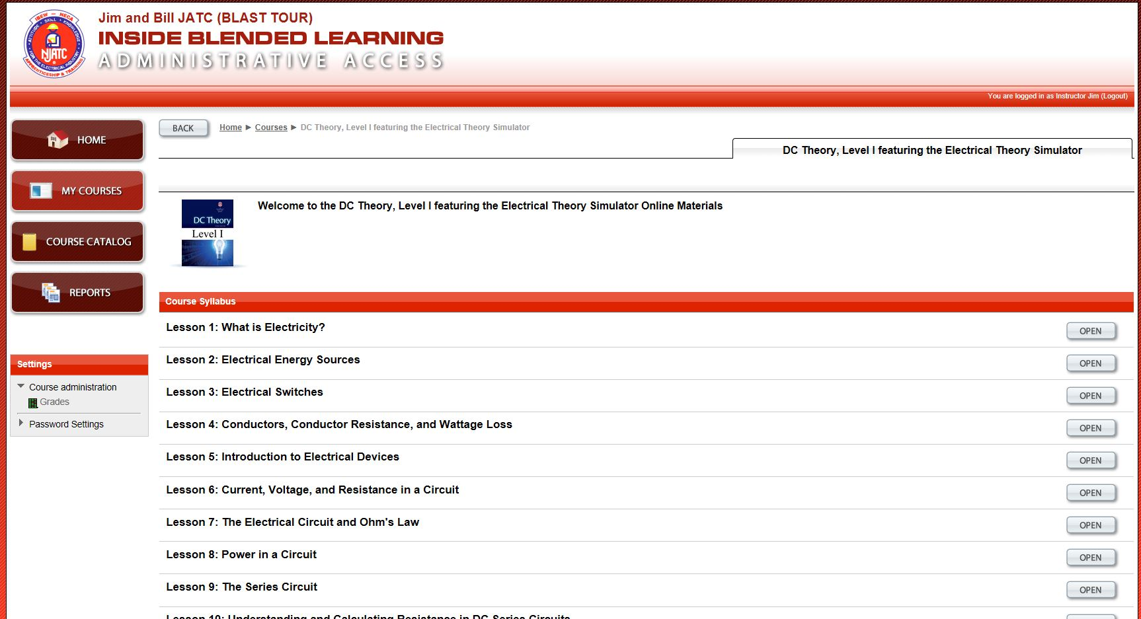
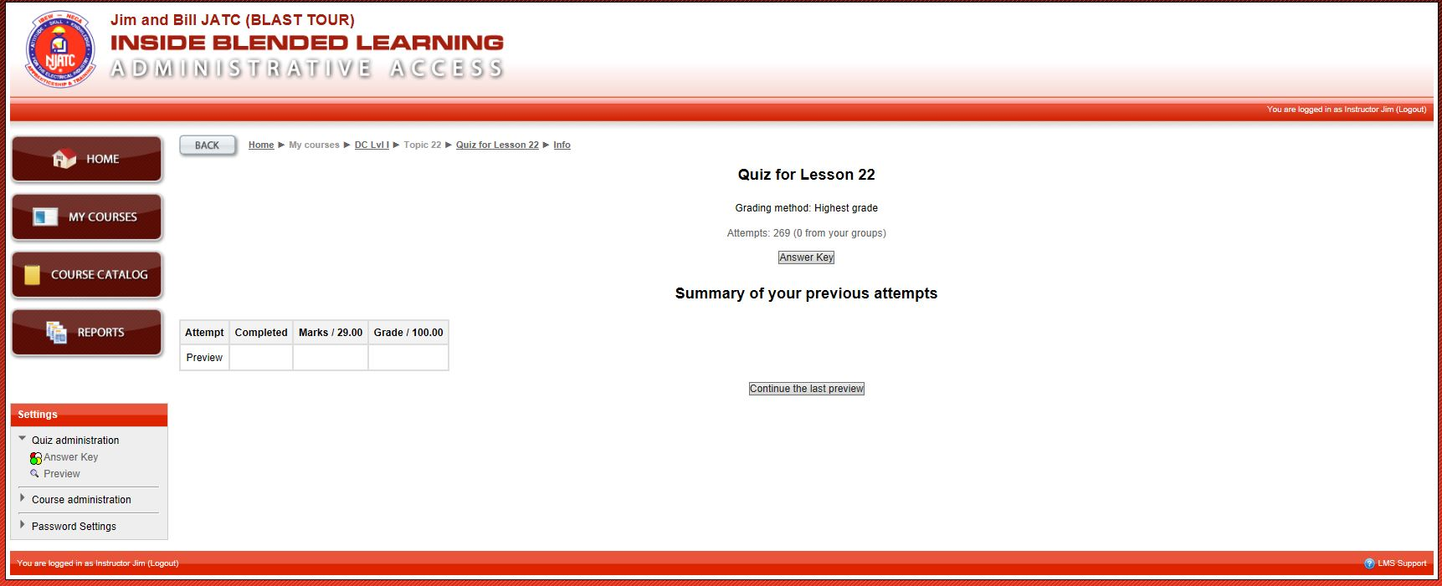
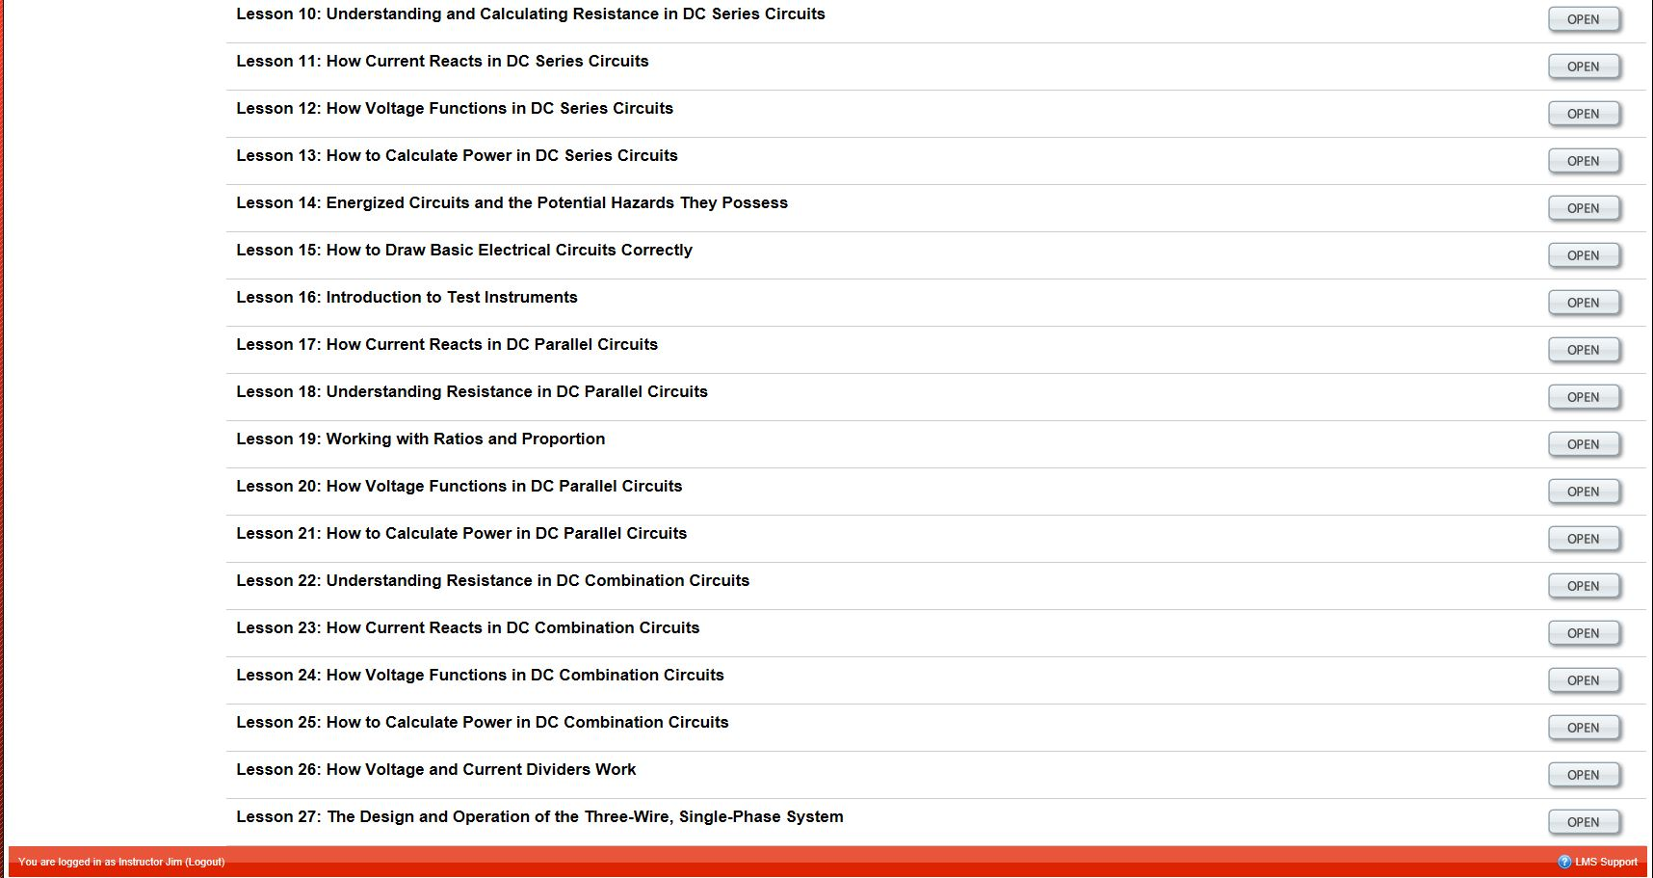
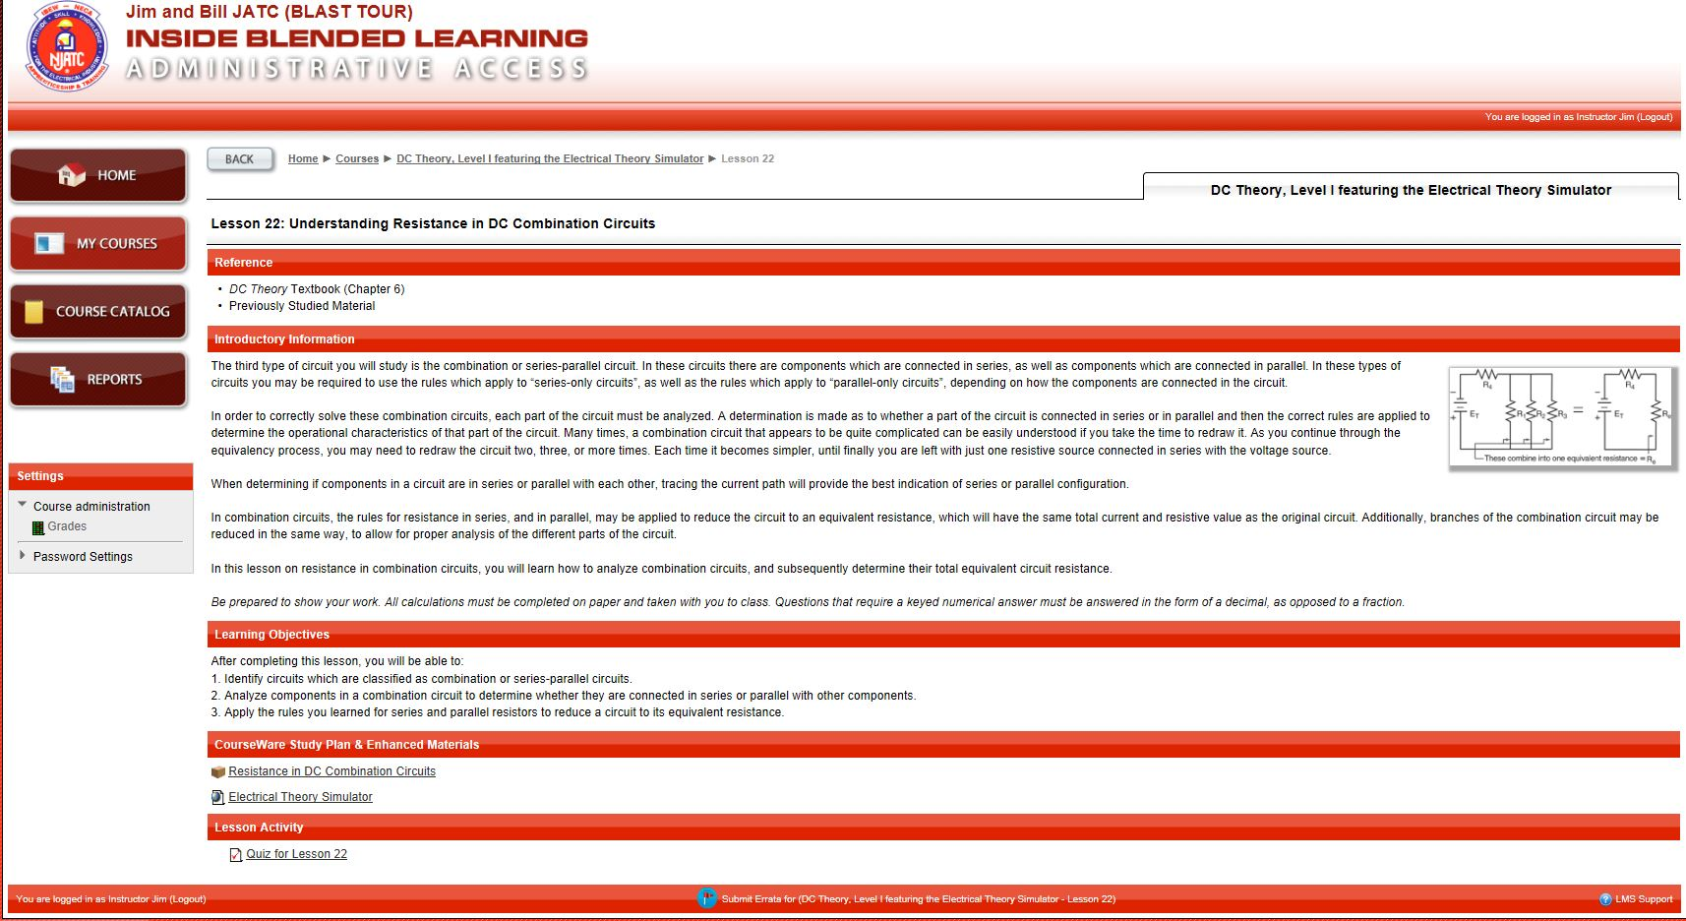
Let’s examine these questions to see what we need to cover in class
Q9
Q15
Q19
Q21
Q22
Q23
Q24
Q26
Q27
Q28
Q29
INSTRUCTOR
Notes:
Jim Boyd Slide

Slide 51
Let’s examine these questions to see what we need to cover in class
Q9
Q15
Q19
Q21
Q22
Q23
Q24
Q26
Q27
Q28
Q29
INSTRUCTOR
Notes:
Jim Boyd Slide

Slide 52
Let’s examine these questions to see what we need to cover in class
Q9
Q15
Q19
Q21
Q22
Q23
Q24
Q26
Q27
Q28
Q29
INSTRUCTOR
Notes:
Jim Boyd Slide

Slide 53
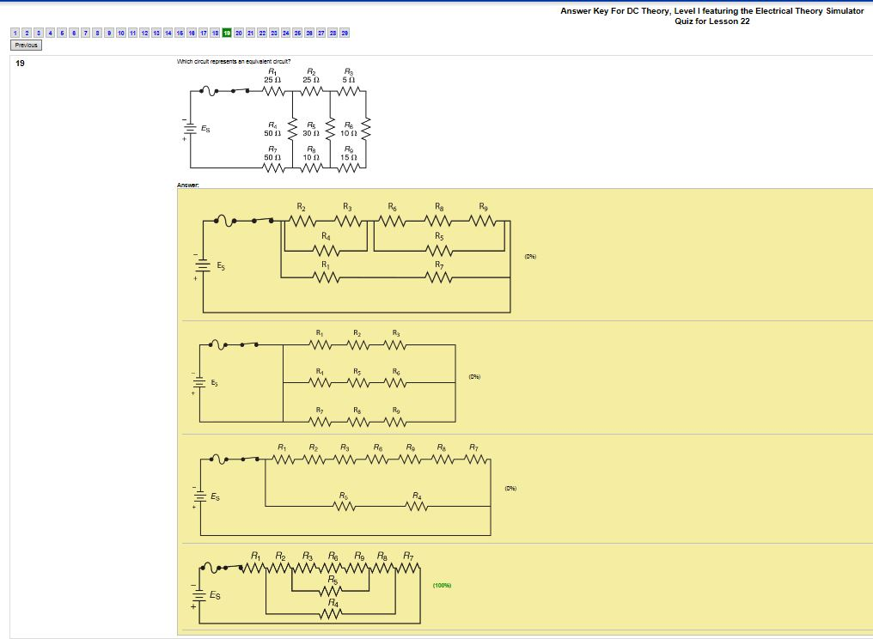
Let’s examine these questions to see what we need to cover in class
Q9
Q15
Q19
Q21
Q22
Q23
Q24
Q26
Q27
Q28
Q29
Notes:
Jim Boyd Slide

Slide 54
Let’s examine these questions to see what we need to cover in class
Q9
Q15
Q19
Q21
Q22
Q23
Q24
Q26
Q27
Q28
Q29
INSTRUCTOR
Notes:
Jim Boyd Slide

Slide 55
Let’s examine these questions to see what we need to cover in class
Q9
Q15
Q19
Q21
Q22
Q23
Q24
Q26
Q27
Q28
Q29
INSTRUCTOR
Notes:
Jim Boyd Slide

Slide 56
In the classroom:
Apprentices understand theory but have problems reducing circuits to equivalent circuits.
They have followed lesson instructions in the past so I think this is the issue
First I will review the process
Then I will demonstrate again using the simulator
Finally, I will give them hands-on problems in the simulator and make them prove each calculation using the meter
Bill is the Training Director
INSTRUCTOR
Notes:
Jim Boyd Slide

Slide 57
LmsAdmin.NJATC.org
TRAINING DIR
Notes:
Bill Ball Slide

Slide 58
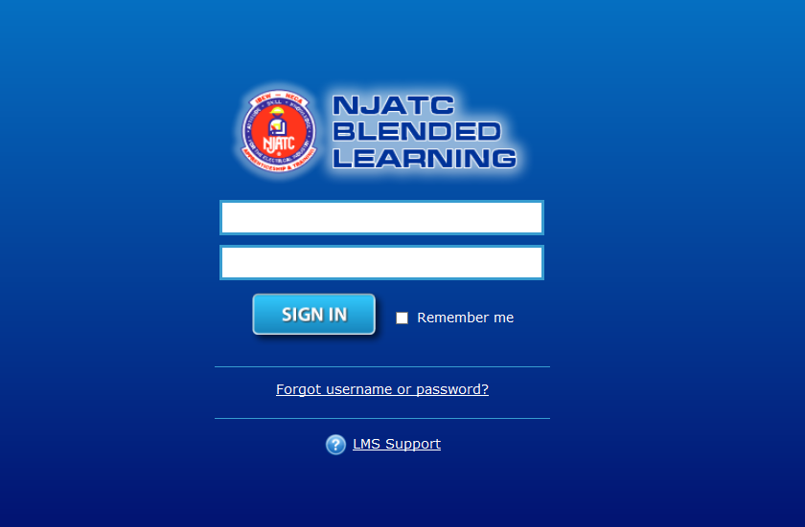
TD-Boss@jatc.org
****************
TRAINING DIR
Notes:
Bill Ball Slide

Slide 59
TRAINING DIR
Notes:
Bill Ball Slide

Slide 60
TRAINING DIR
Notes:
Bill Ball Slide

Slide 61
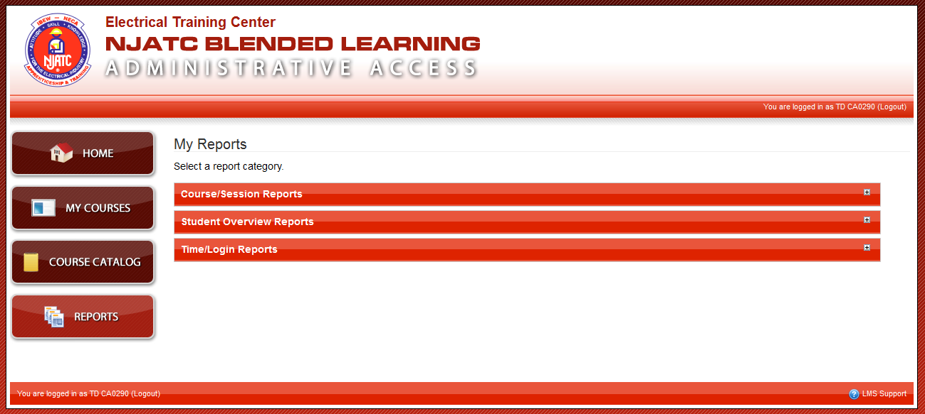
TRAINING DIR
Notes:
Bill Ball Slide

Slide 62
TRAINING DIR
Notes:
Bill Ball Slide

Slide 63
TRAINING DIR
Notes:
Bill Ball Slide

Slide 64
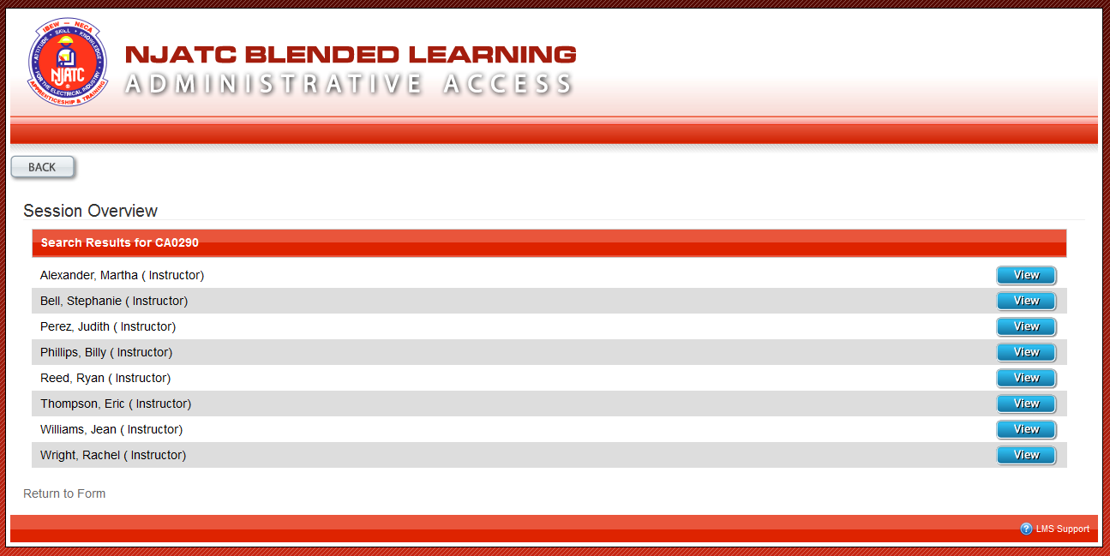
TRAINING DIR
Notes:
Bill Ball Slide

Slide 65
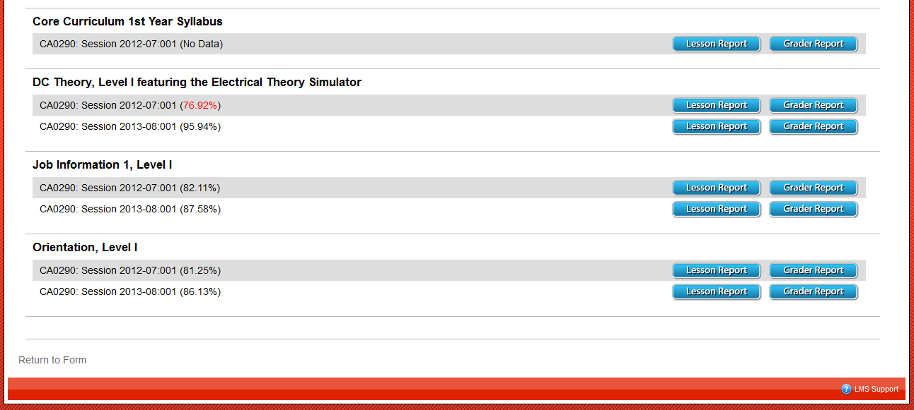
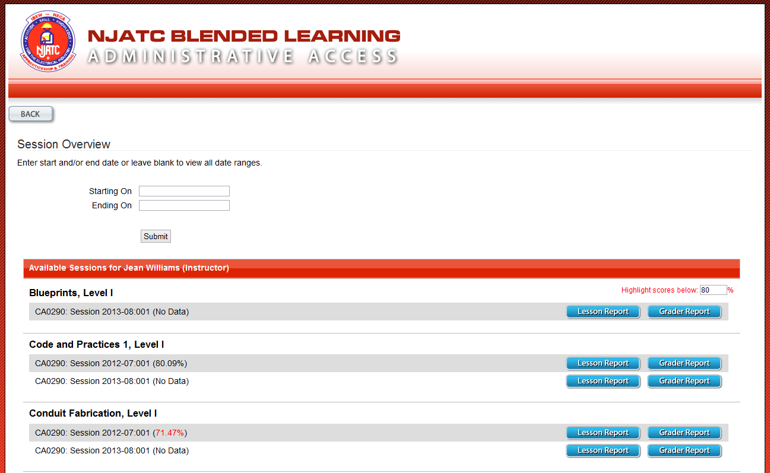
TRAINING DIR
Notes:
Bill Ball Slide

Slide 66
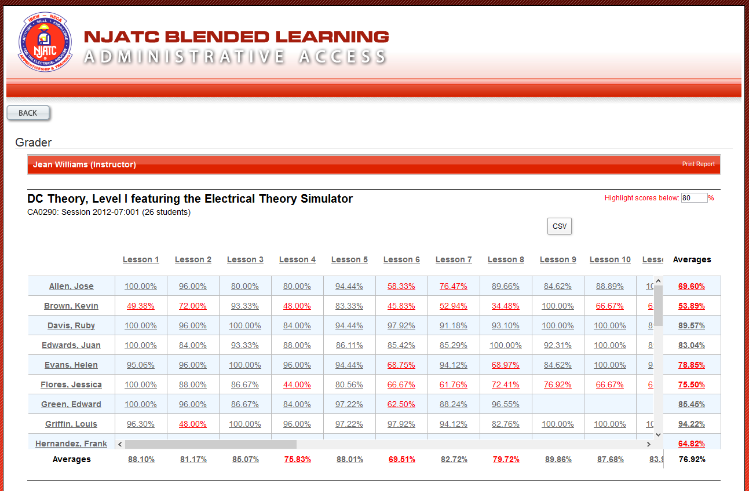
TRAINING DIR
Notes:
Bill Ball Slide

Slide 67
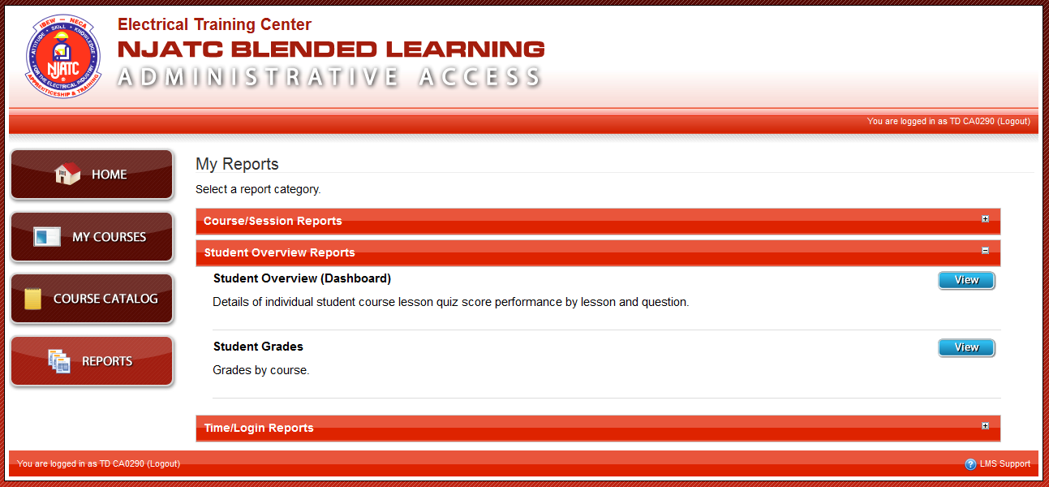
TRAINING DIR
Notes:
Bill Ball Slide

Slide 68
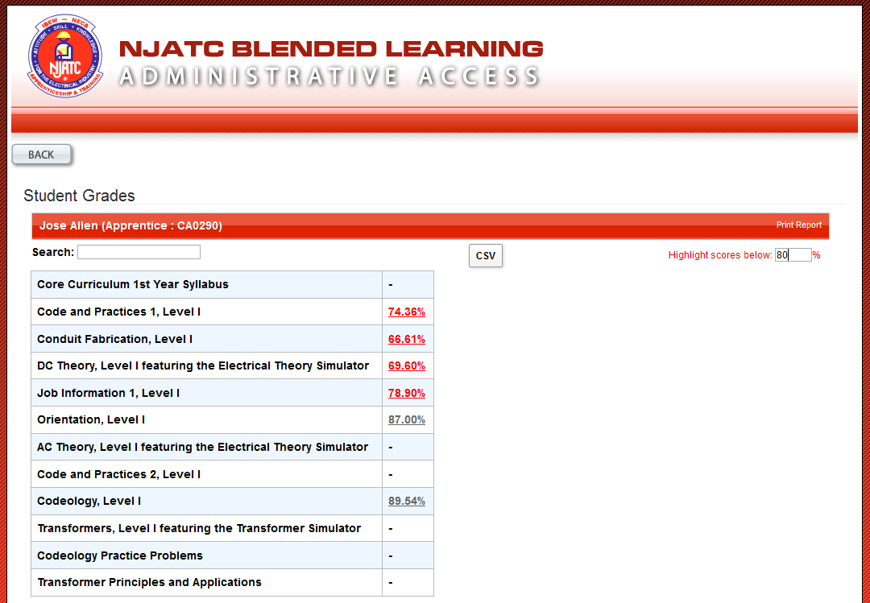
TRAINING DIR
Notes:
Bill Ball Slide

Slide 69
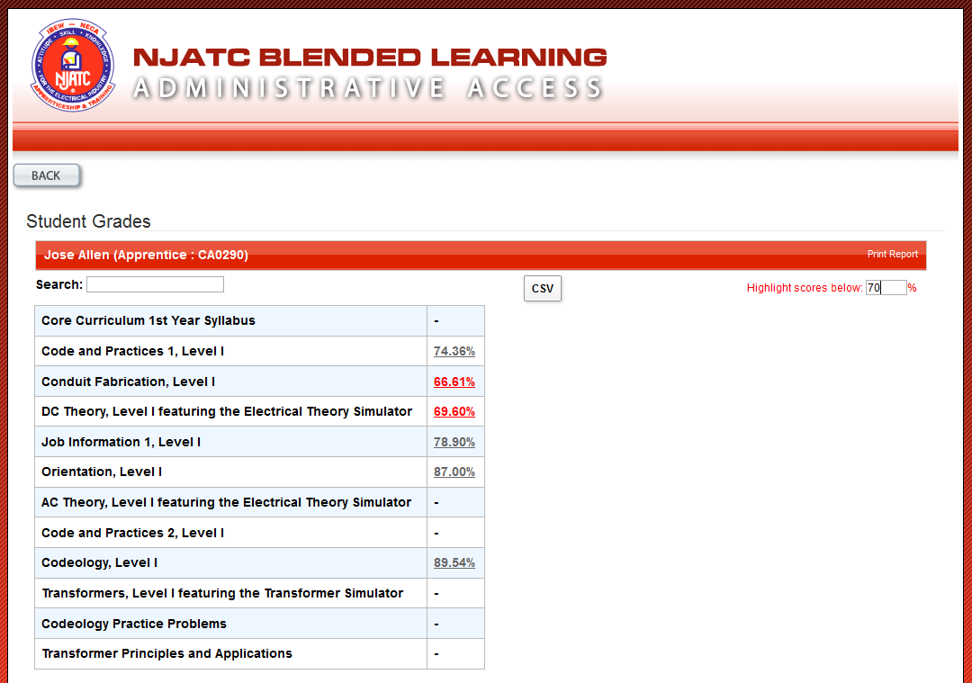
TRAINING DIR
Notes:
Bill Ball Slide

Slide 70
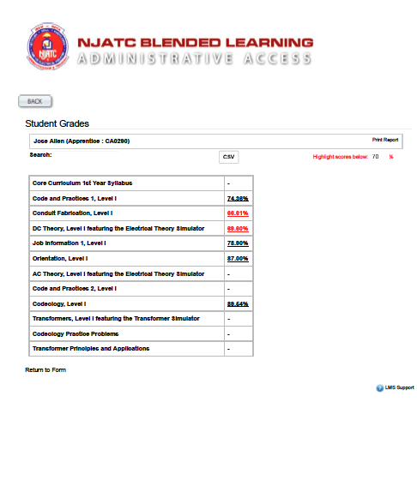
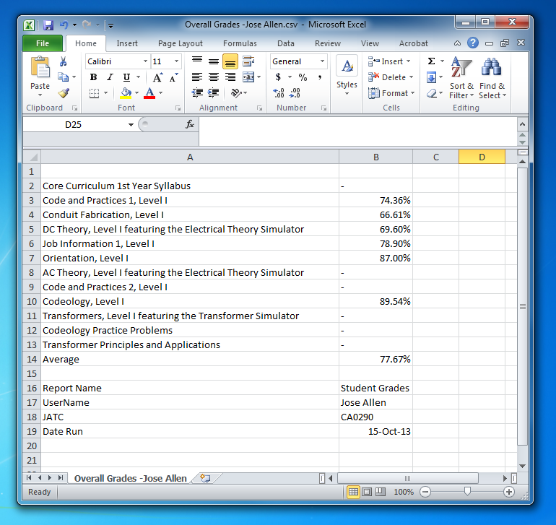
TRAINING DIR
Notes:
Bill Ball Slide

Slide 71
…all in the week of Blended Learning…
Notes:
Bill Ball Slide

