Slide 2
Next Week
DC Theory: Lesson 22
Understanding Resistance in DC Combination Circuits
Combination Circuits
Require the use of earlier skills
Series Resistors
Parallel Resistors
May be solved using skill which you already have demonstrated
Example
INSTRUCTOR

Slide 3
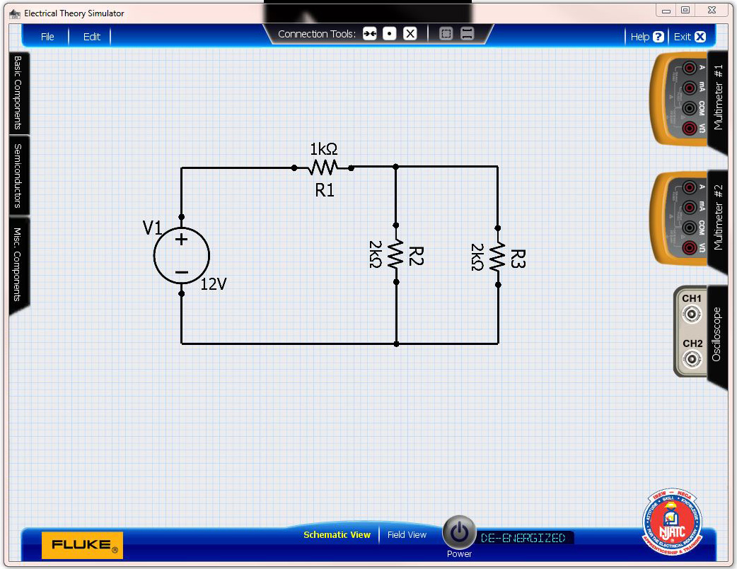
RT = ?
INSTRUCTOR

Slide 4
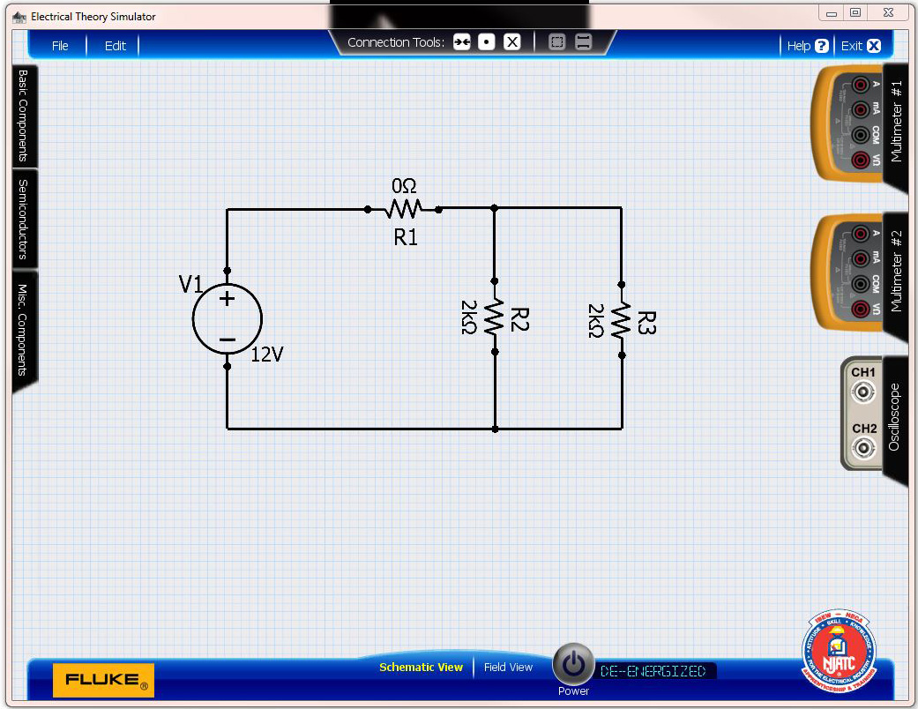
Assume R₁ = 0 Ω
R_{T} = ?
INSTRUCTOR

Slide 5
New Circuit
R_{T} = ?
INSTRUCTOR

Slide 6
Solve for R₂ and R₃ in Parallel
R_{T} = (R₂ x R₃) / (R₂ + R₃)
R_{T} = 2,000 x 2,000 = 1,000 Ω
2,000 + 2,000
INSTRUCTOR

Slide 7
Add R₁ back into the circuit
R_{T} = ?
INSTRUCTOR

Slide 8
Solve R₁ and R₂₃ in Series
R_{T} = R₁ + R₂₃
R_{T} = 1,000 + 1,000 = 2,000 Ω
INSTRUCTOR

Slide 9
Prove the calculation by removing the Power Source and measuring the resistance in the original combination circuit
INSTRUCTOR

Slide 10
Reminder:
Next Class Assignment: DC Theory Lesson 22
HINT: Use the simulator to verify quizzes
Homework is due Sunday before 8:00 PM
If you have questions, you may email me before Friday at 9:00 PM and I will respond to all emails within 24 hours. ( jeanwilliams@njatc.org )
INSTRUCTOR

Slide 11
Bill is an Apprentice

Slide 13
INSTRUCTOR

Slide 14
INSTRUCTOR

Slide 15
Bill is an Apprentice

Slide 16
INSTRUCTOR

Slide 17
INSTRUCTOR

Slide 18
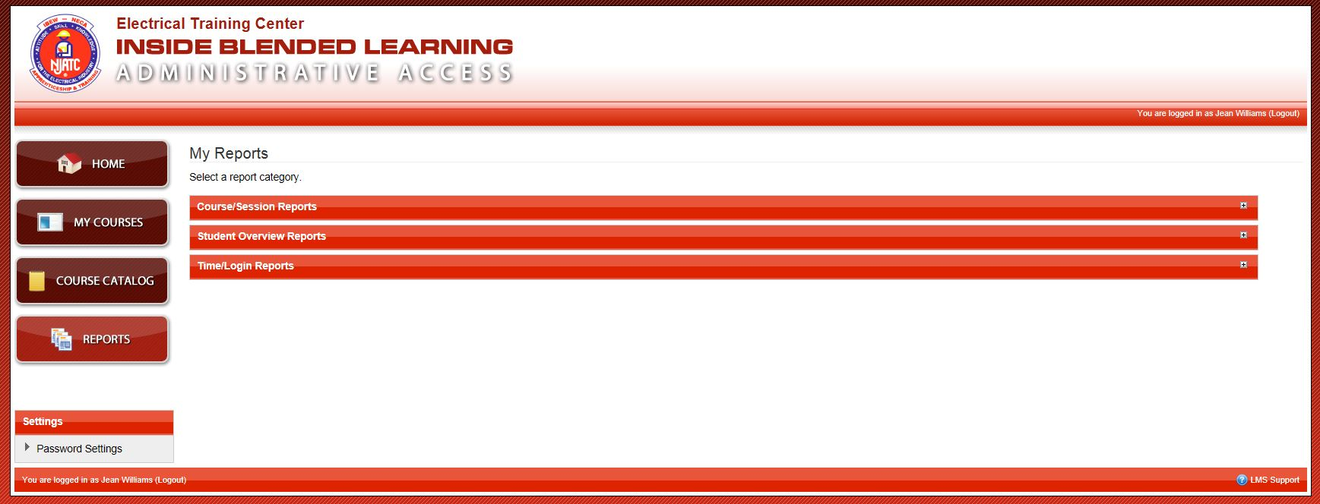
INSTRUCTOR

Slide 19
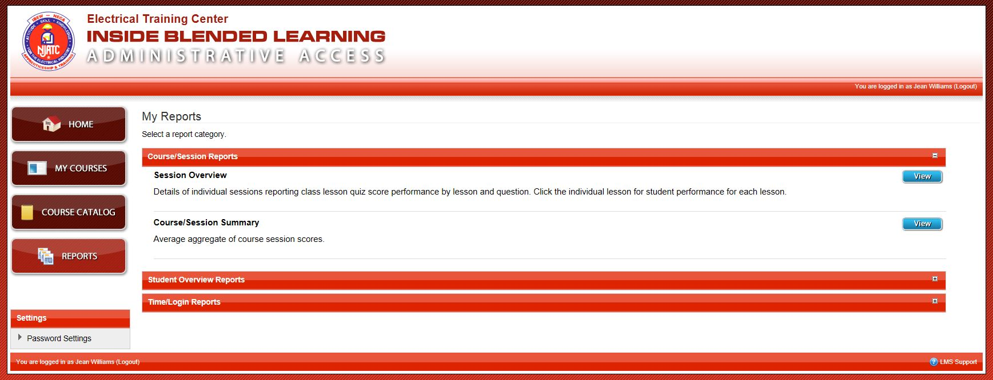
INSTRUCTOR

Slide 20
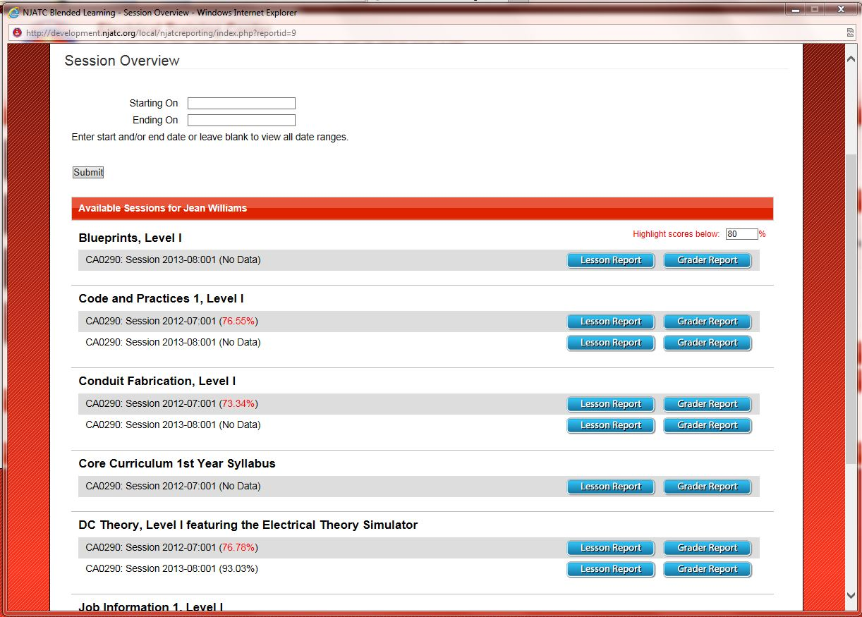

Slide 21
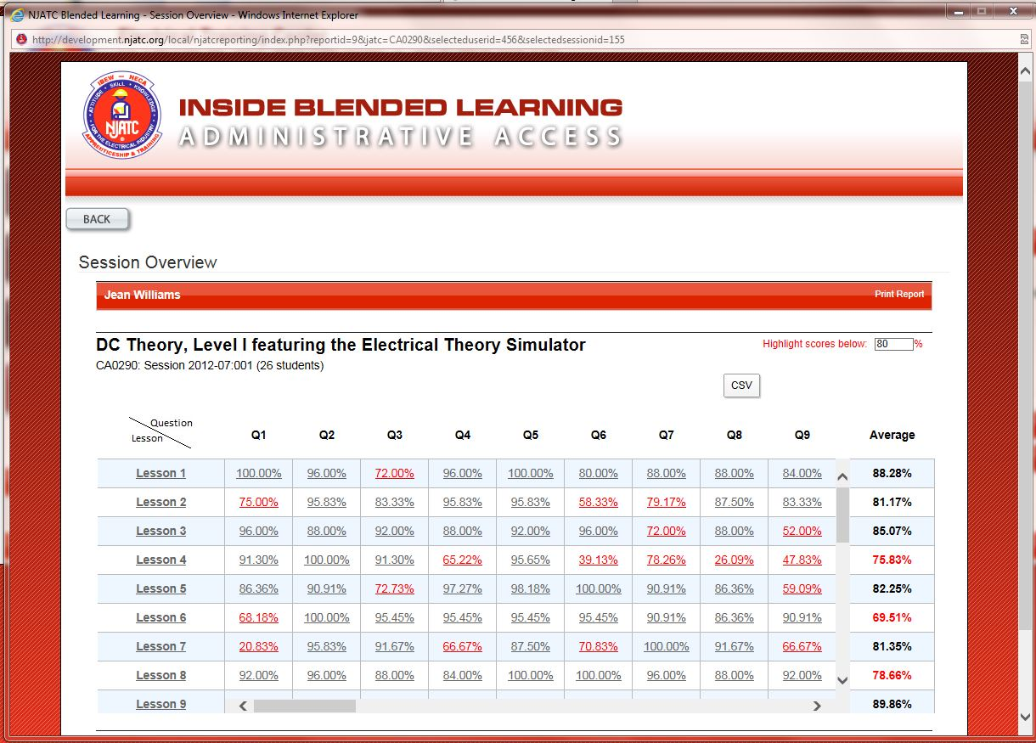

Slide 22
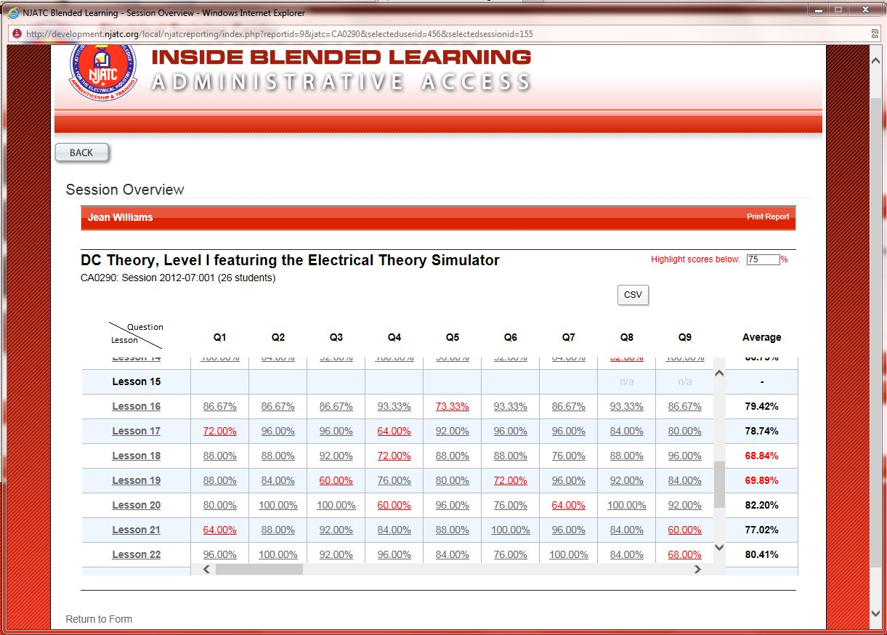

Slide 23
LESSON 22
Question 9 – 68%
Question 15 – 72%
Question 19 – 64%
Question 21 – 72%
Question 22 – 60%
Question 23 – 68%
Question 24 – 64%
Question 26 – 68%
Question 27 – 72%
Question 28 – 72%
Question 29 – 44%
INSTRUCTOR

Slide 24
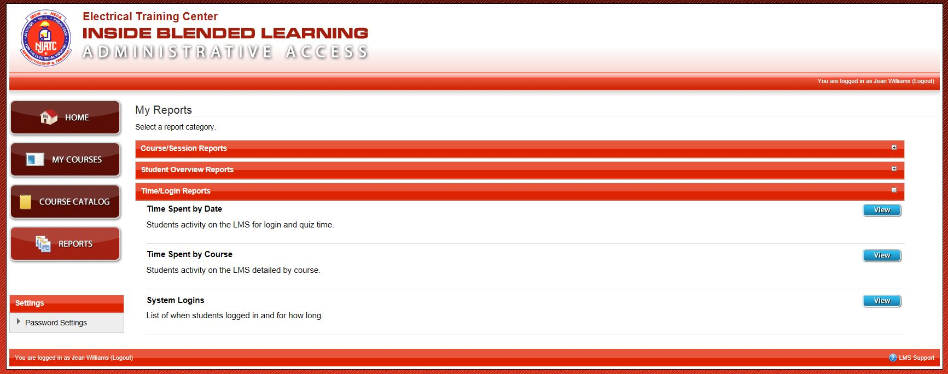
INSTRUCTOR

Slide 25
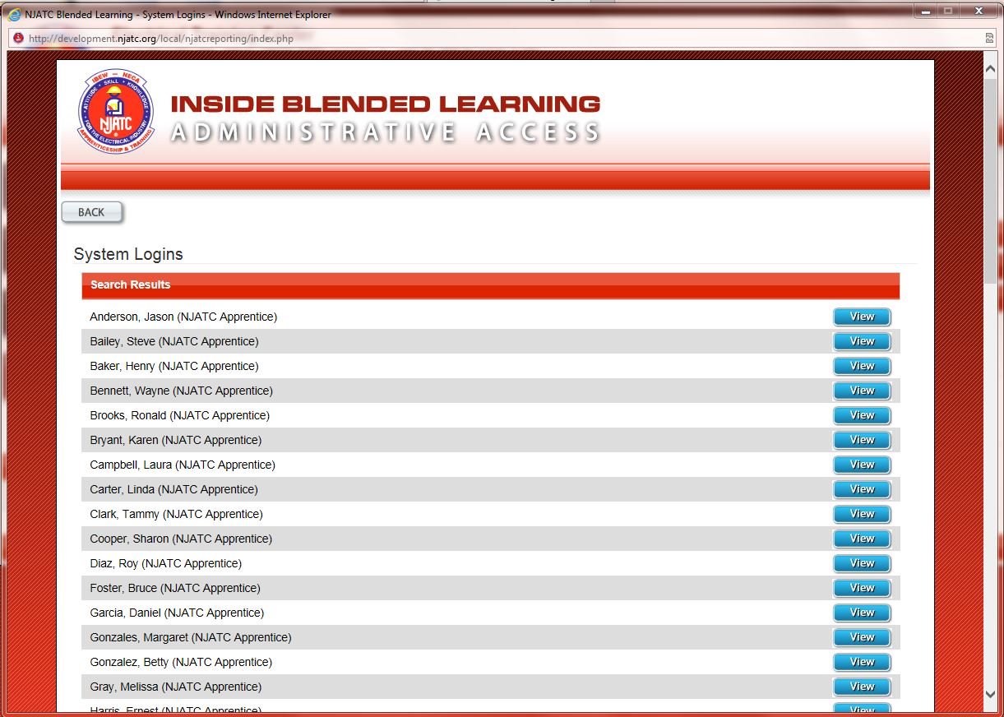

Slide 26
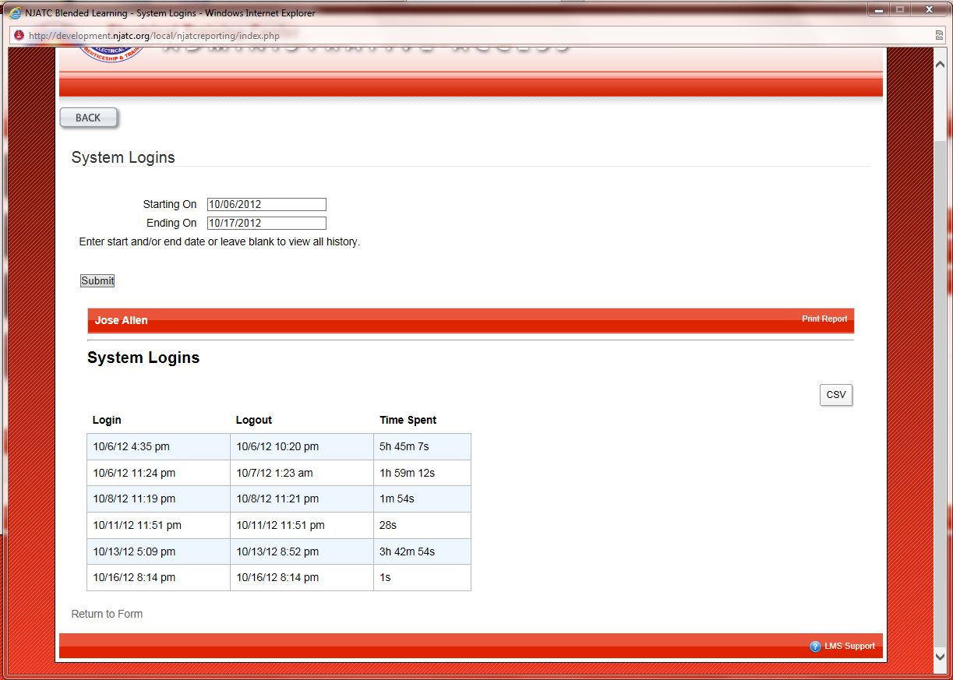

Slide 27
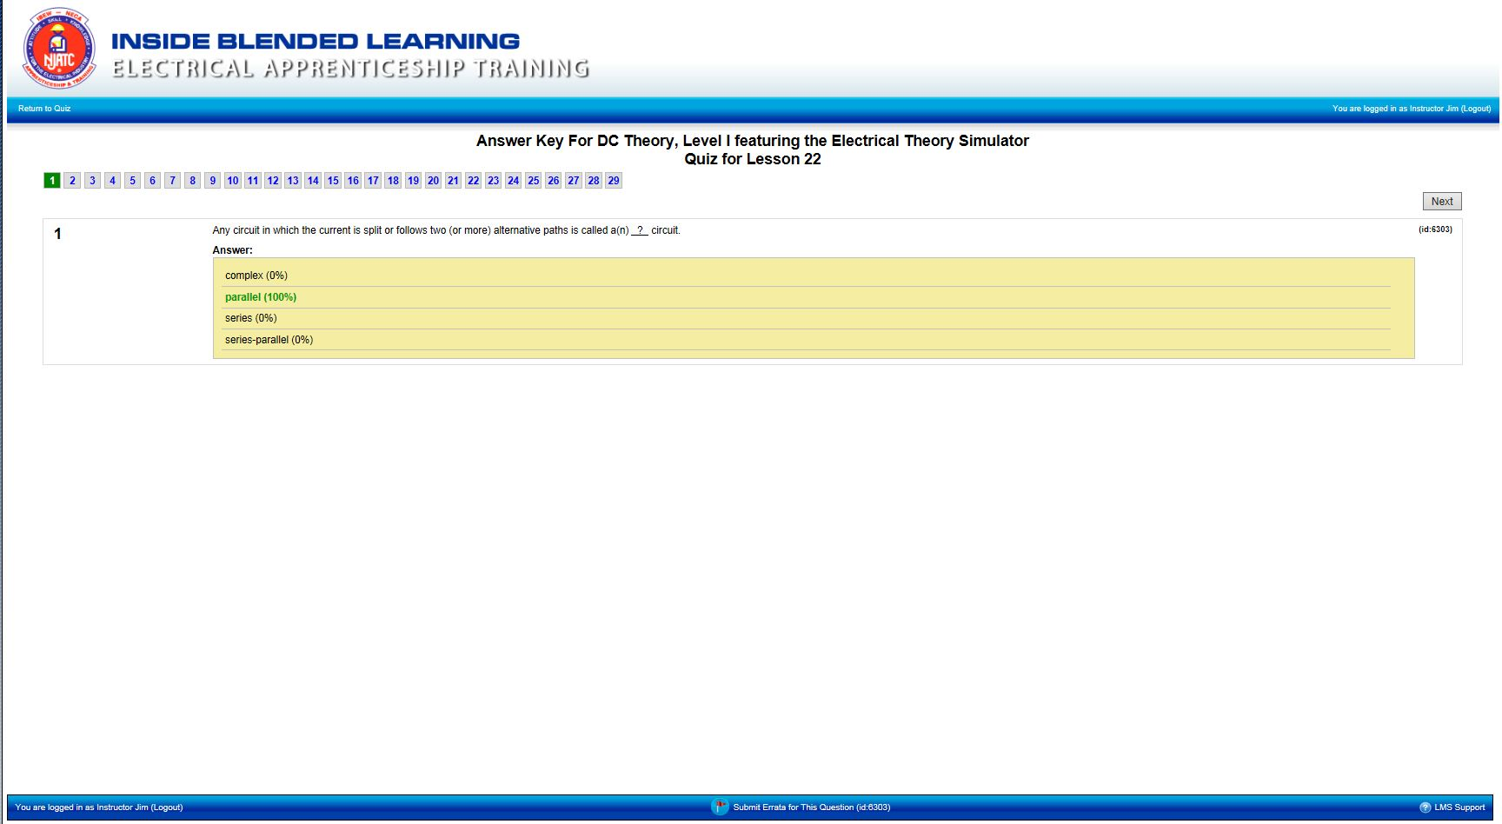
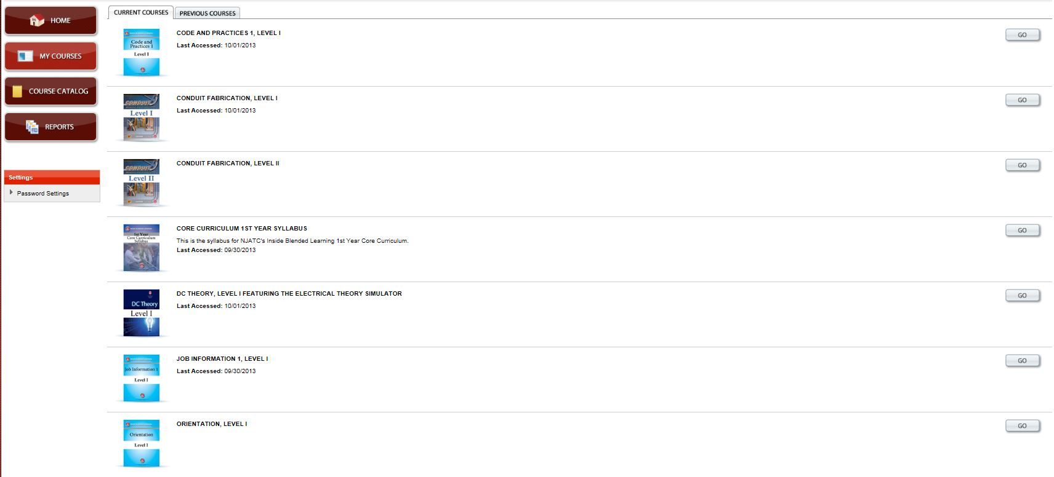
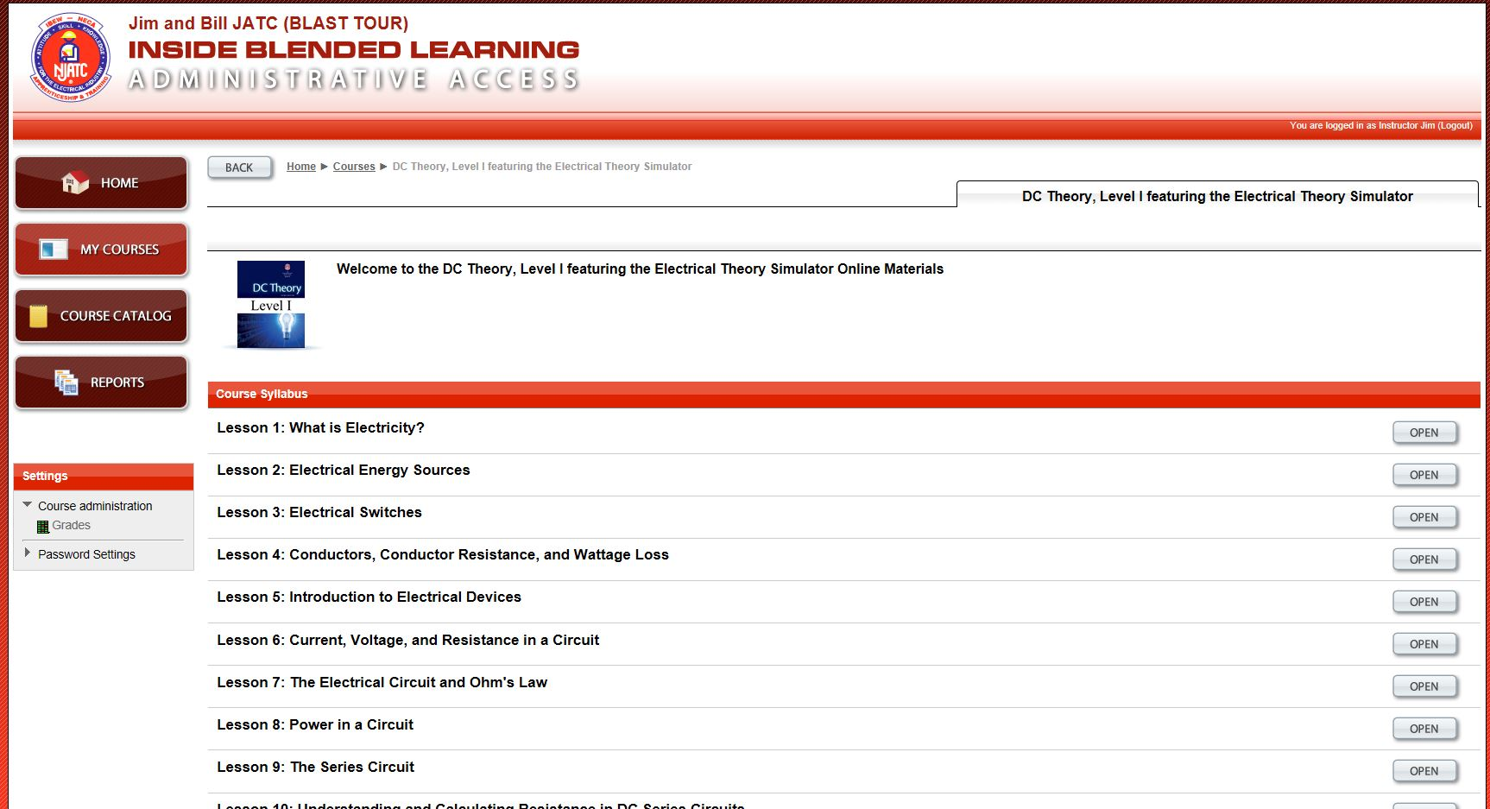
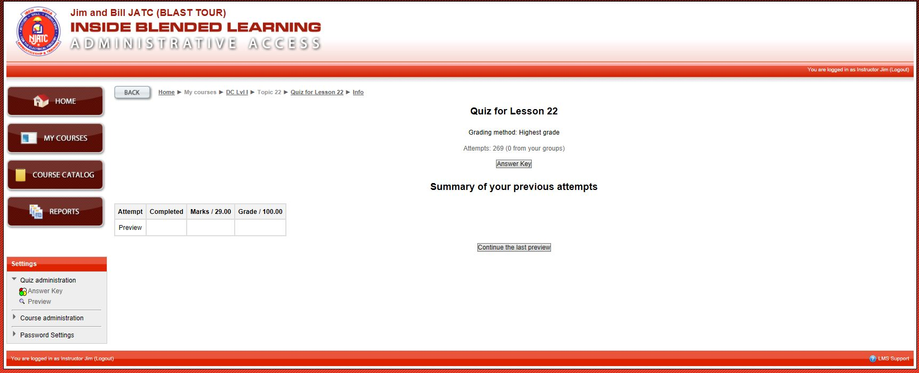
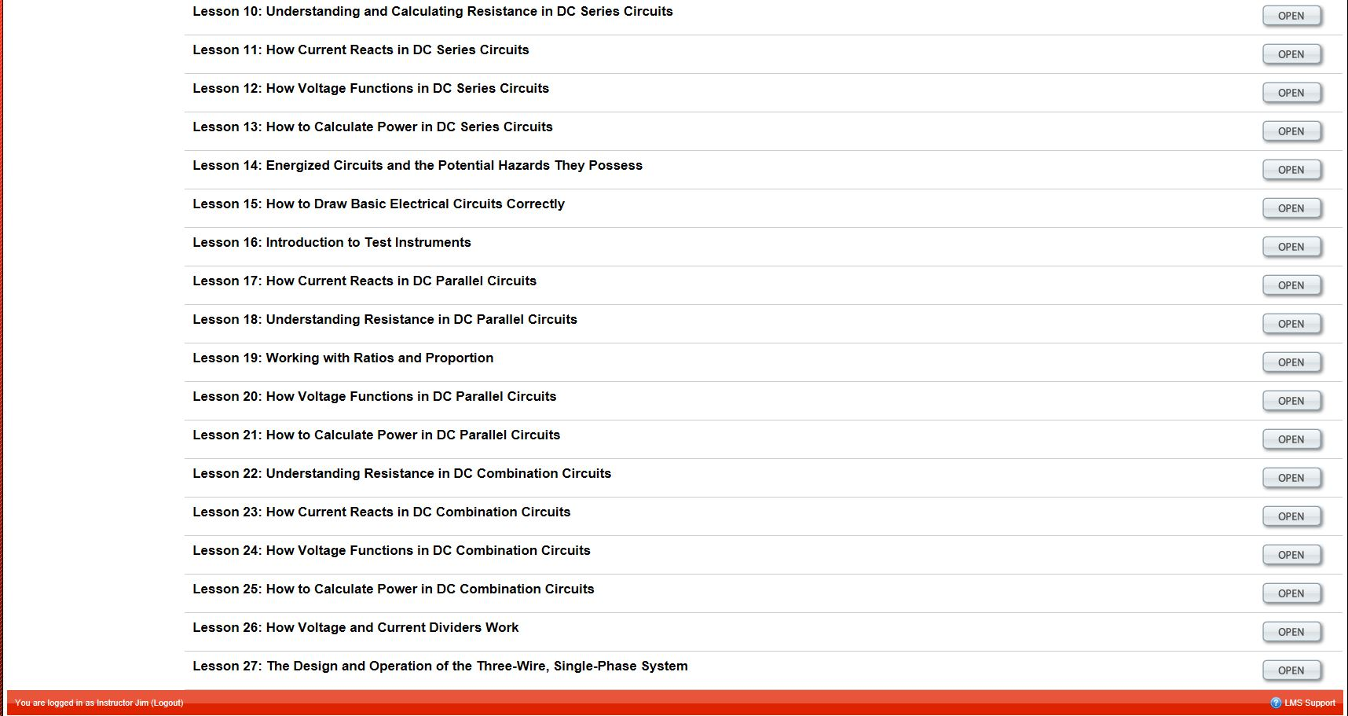
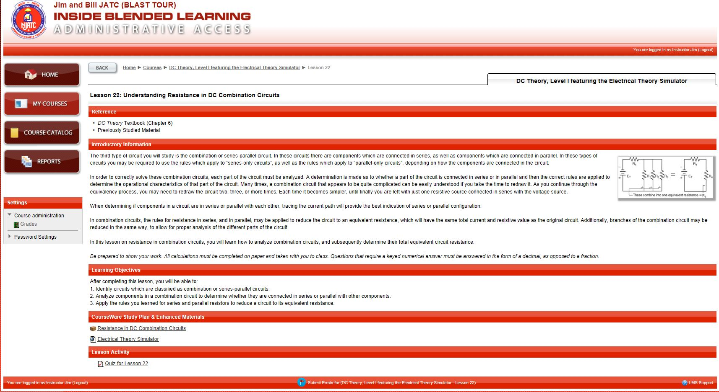
Let’s examine these questions to see what we need to cover in class
Q9
Q15
Q19
Q21
Q22
Q23
Q24
Q26
Q27
Q28
Q29
INSTRUCTOR

Slide 28
Let’s examine these questions to see what we need to cover in class
Q9
Q15
Q19
Q21
Q22
Q23
Q24
Q26
Q27
Q28
Q29
INSTRUCTOR

Slide 29
Let’s examine these questions to see what we need to cover in class
Q9
Q15
Q19
Q21
Q22
Q23
Q24
Q26
Q27
Q28
Q29
INSTRUCTOR

Slide 30
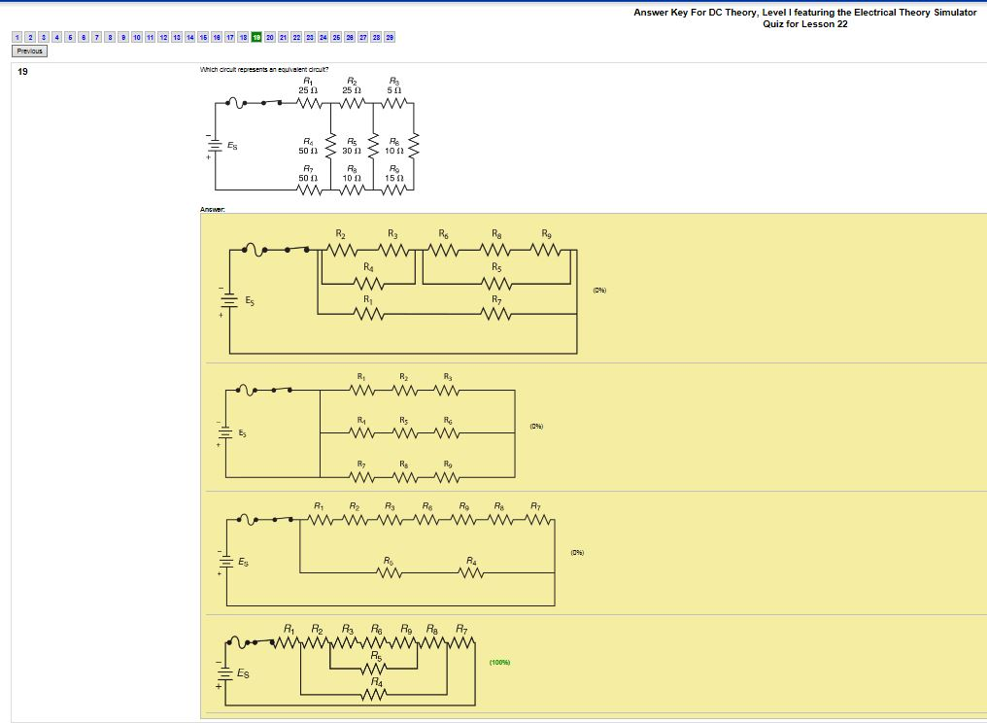
Let’s examine these questions to see what we need to cover in class
Q9
Q15
Q19
Q21
Q22
Q23
Q24
Q26
Q27
Q28
Q29

Slide 31
Let’s examine these questions to see what we need to cover in class
Q9
Q15
Q19
Q21
Q22
Q23
Q24
Q26
Q27
Q28
Q29
INSTRUCTOR

Slide 32
Let’s examine these questions to see what we need to cover in class
Q9
Q15
Q19
Q21
Q22
Q23
Q24
Q26
Q27
Q28
Q29
INSTRUCTOR

Slide 33
In the classroom:
Several Apprentices understand how to do combination circuits so I will have those apprentices work quietly in two groups on some advanced problems.
I will have the groups compete to see which group can solve the problems quicker.
The remainder of the Apprentices understand the theory but have problems reducing problems to equivalent circuits.
They have been able to follow lesson instructions in the past so I think the reduction process is the issue
First I will review the process
Then I will demonstrate again using the simulator
Finally, I will give them hands-on problems in the simulator and make them prove each calculation using the meter
Bill is a Training Director
INSTRUCTOR

